Slide 1
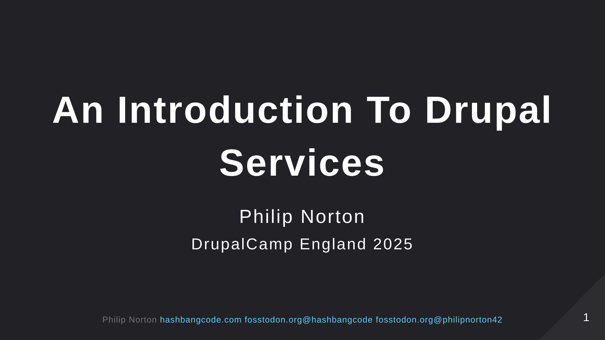

Slide 2

Notes:
- Doing Drupal for about 15 years. - Programming in general for about 20 now. - That is a picture of a Lily58 mechanical keyboard.

Slide 3
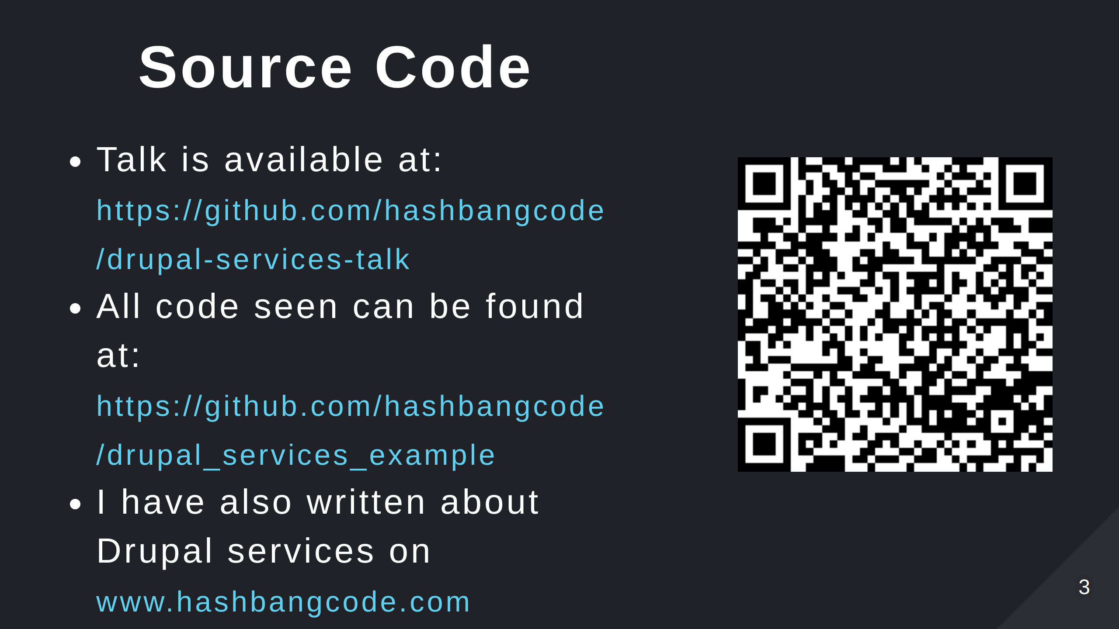
Notes:
- Scan the QR code for the talk repo. Which has links to all of the resources you need.

Slide 4
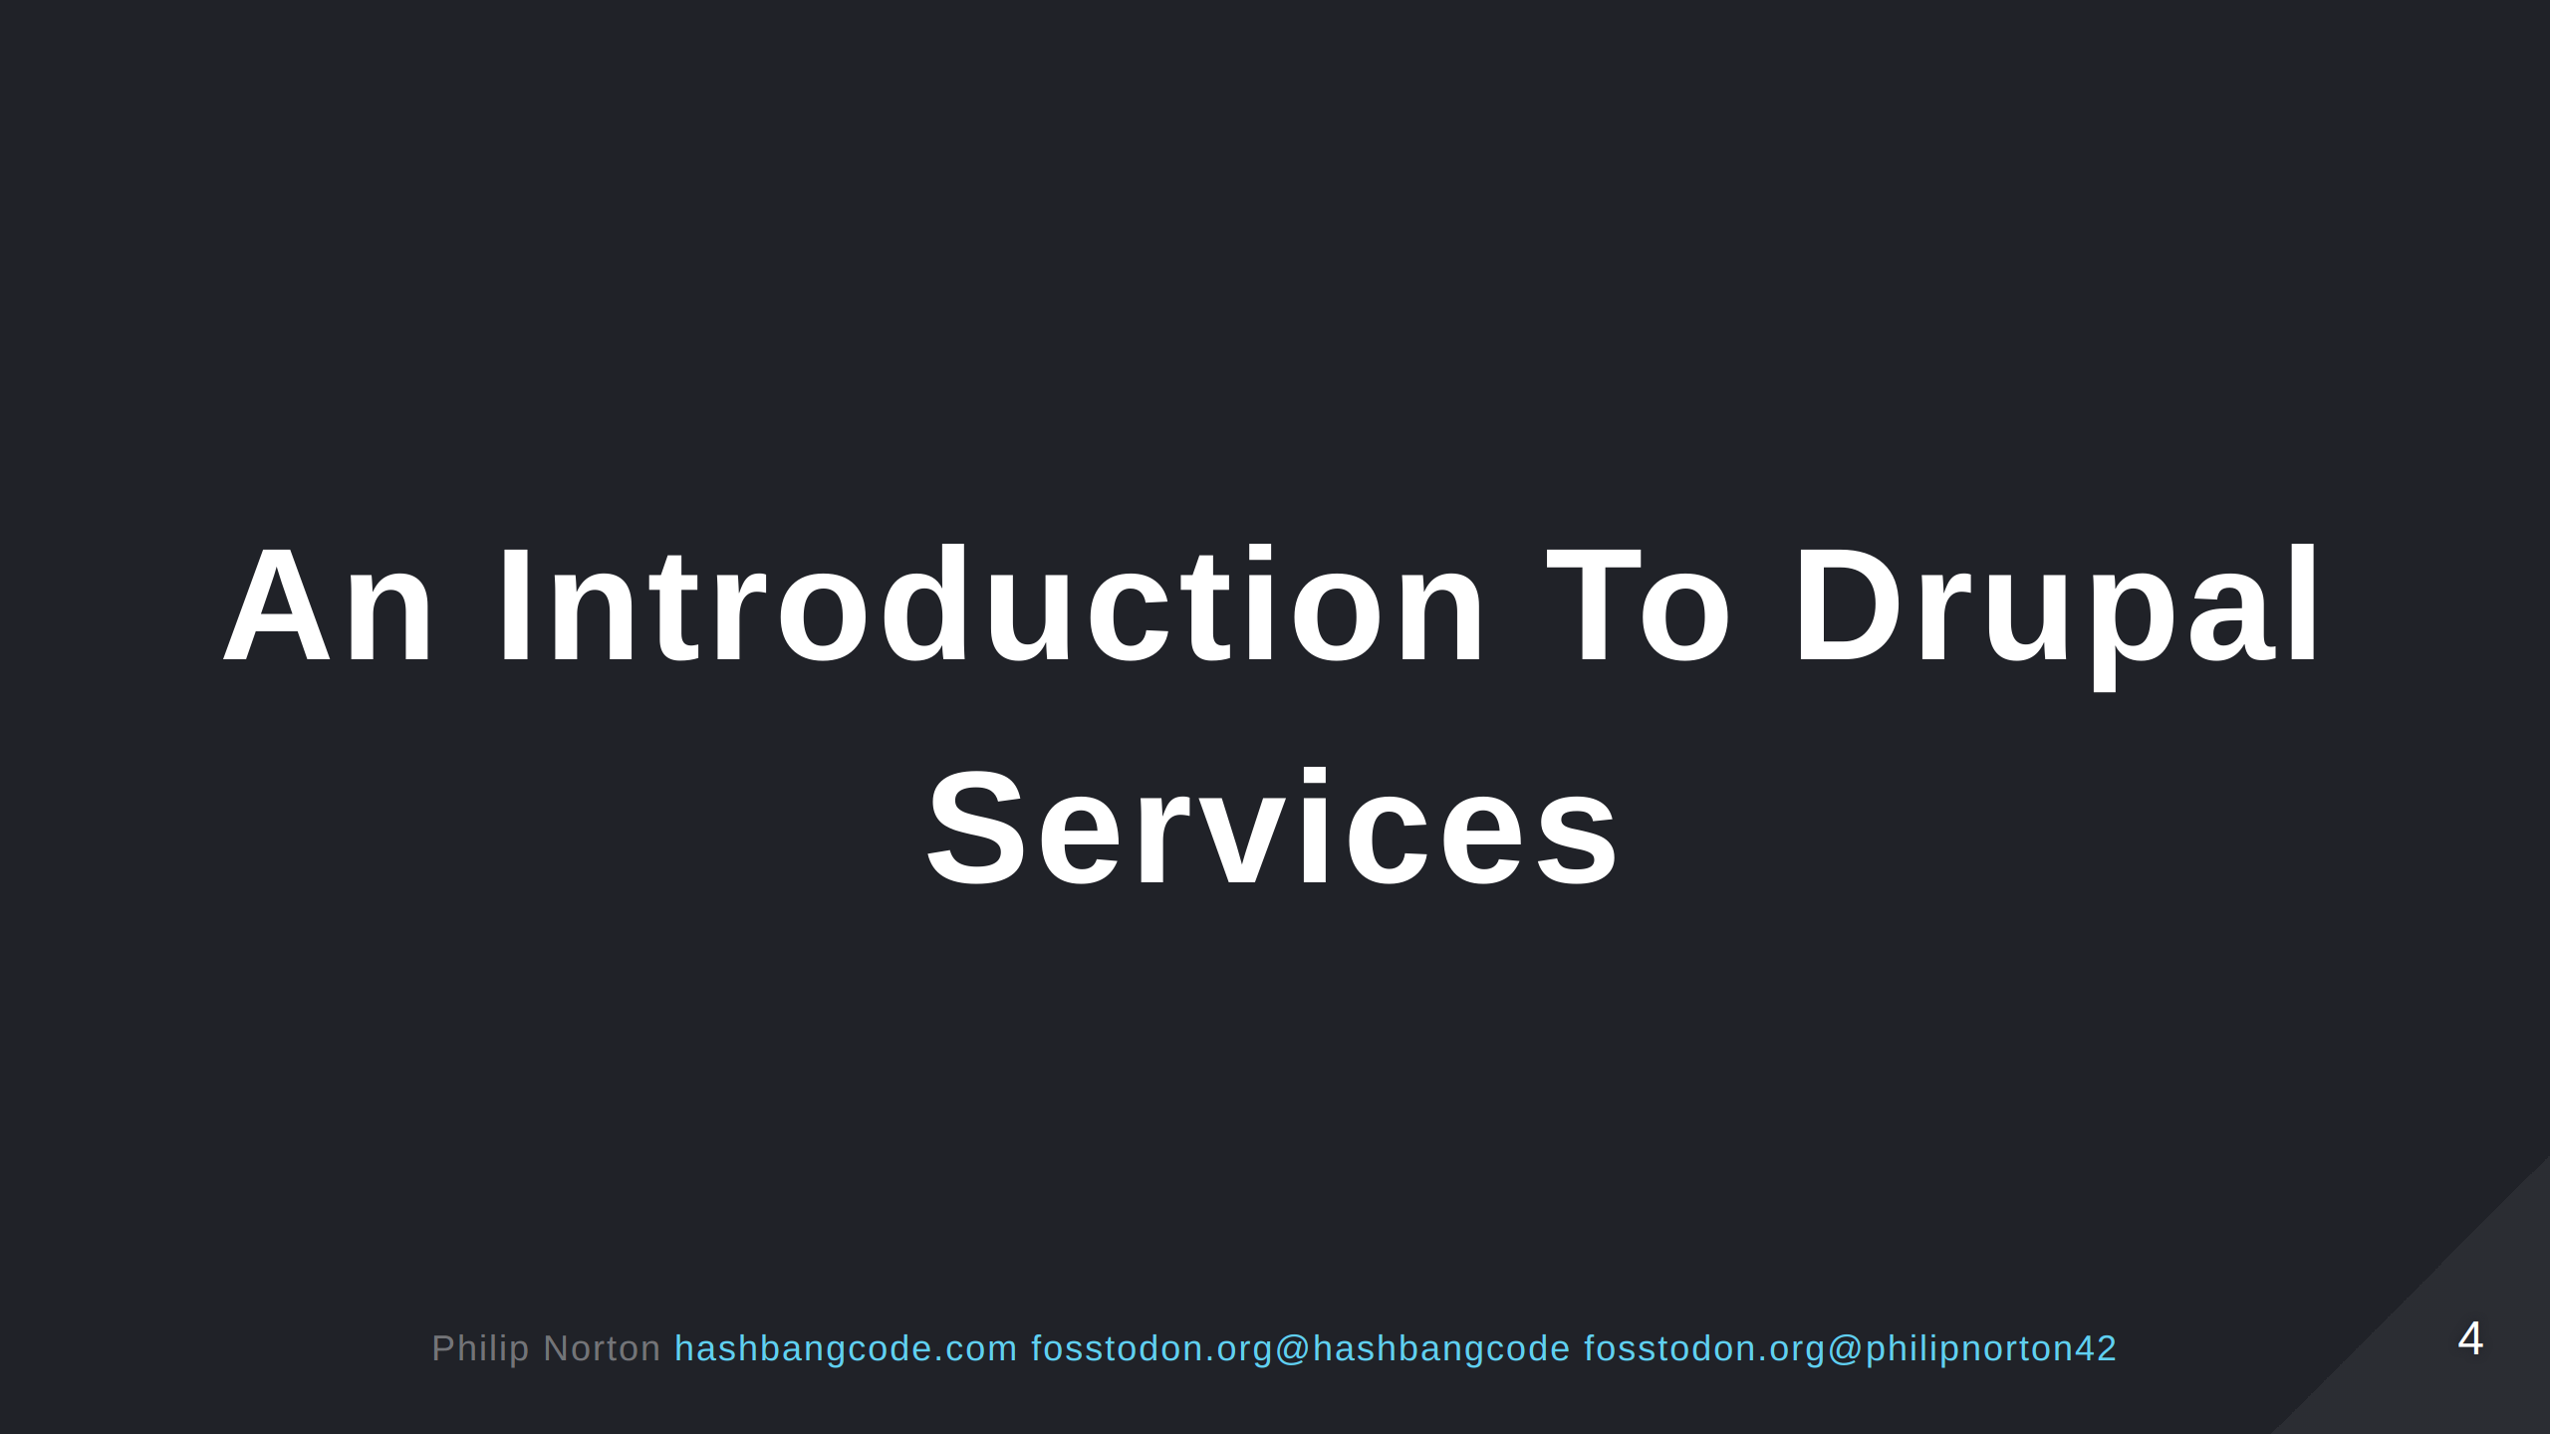
Notes:
Drupal services are an integral part of how Drupal is structured internally. Everything from connecting to a database to decoding JSON has a service you can use to do it. This talk will introduce you to what services are and how to use them. We'll talk about why they are used and then go onto building our own services. This talk will assume you have some understanding of PHP, but if you get lost then please ask me to talk you throught stuff afterwards.

Slide 5
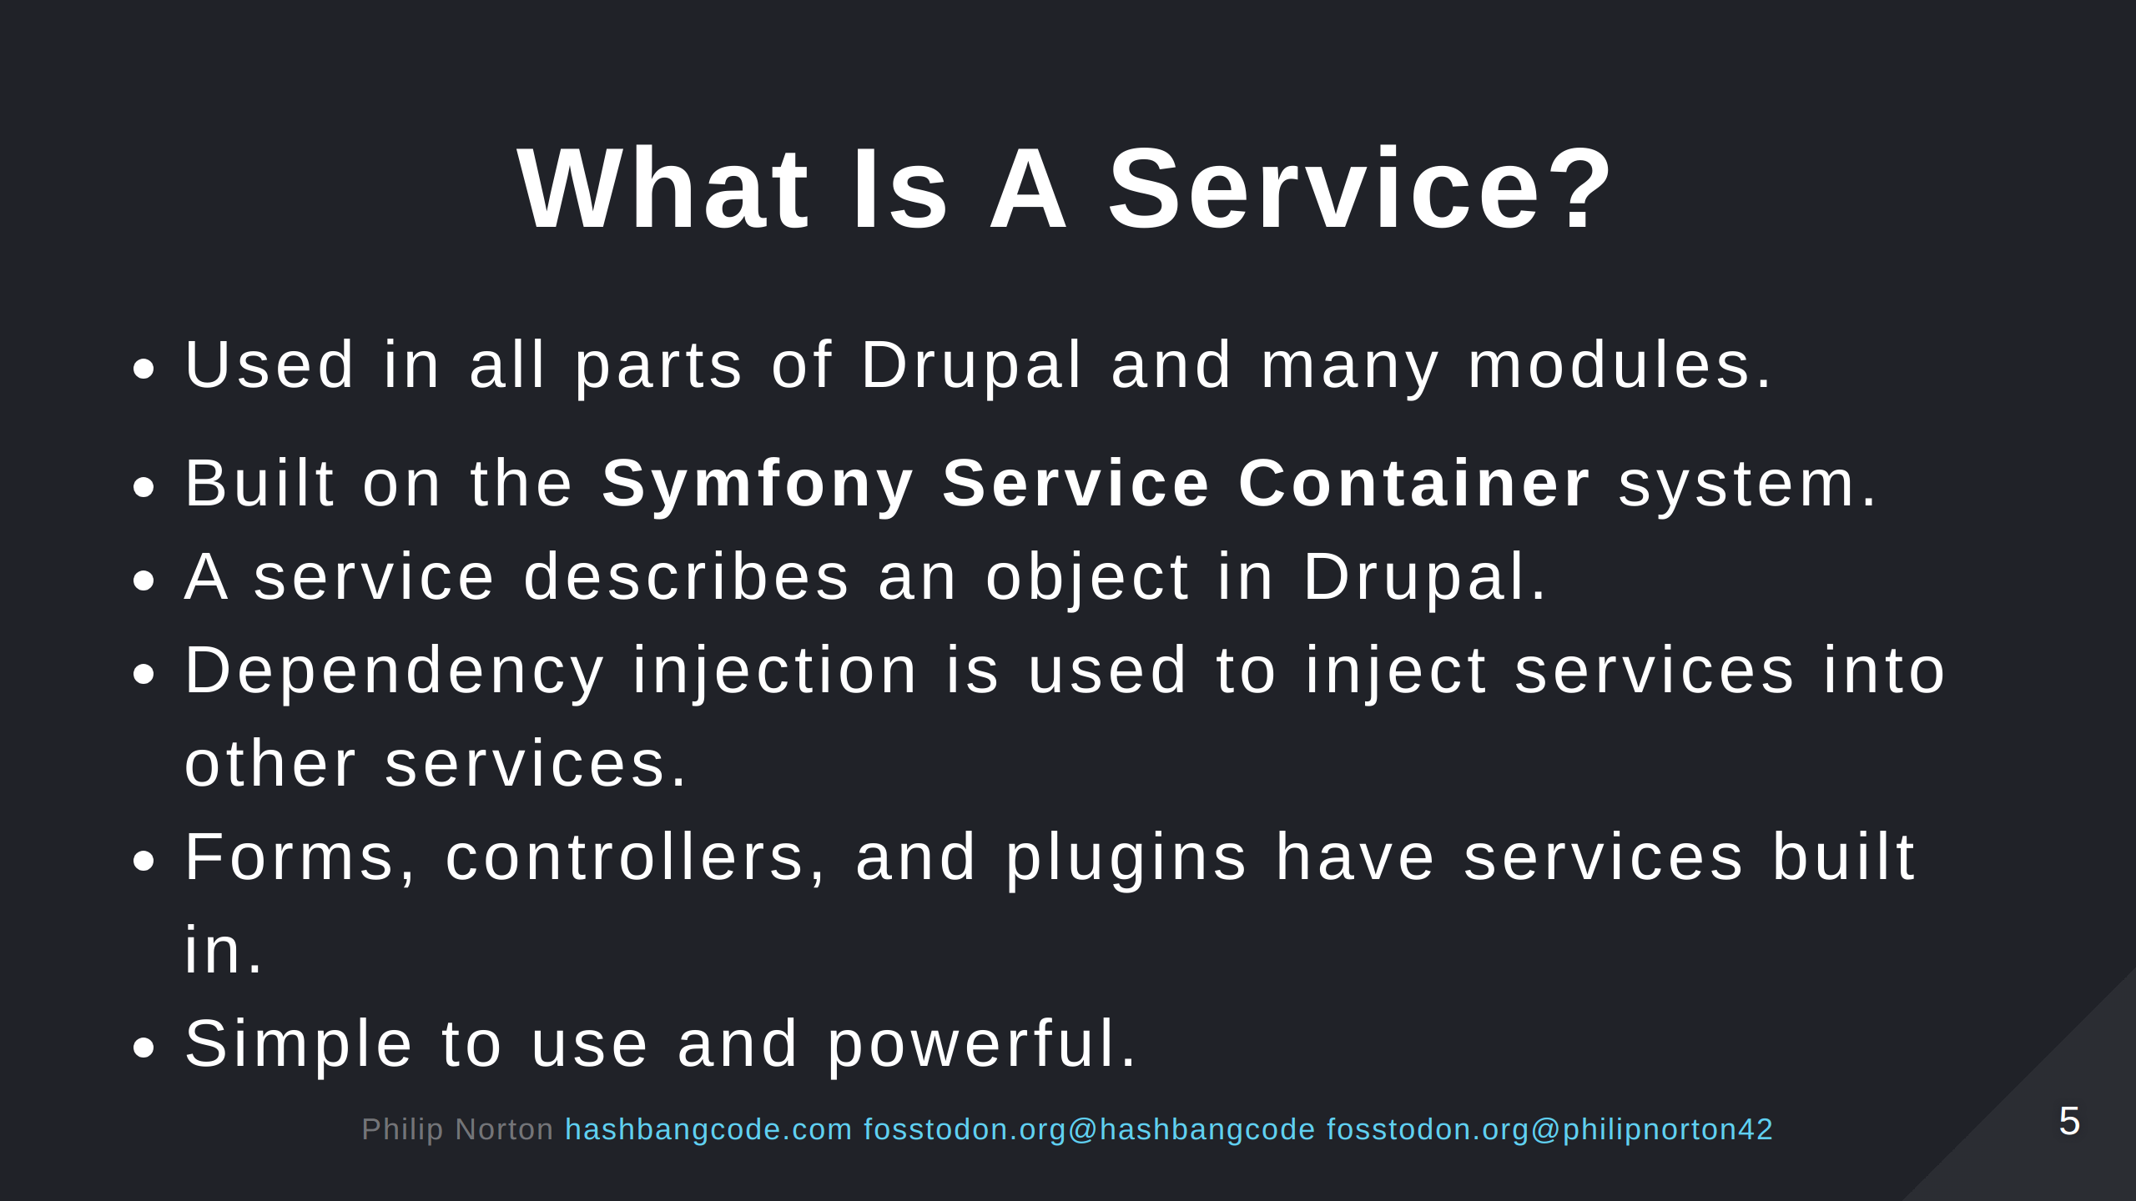

Slide 6
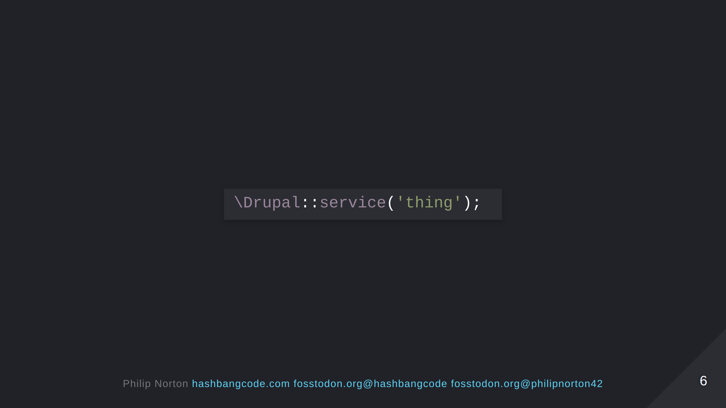

Slide 7
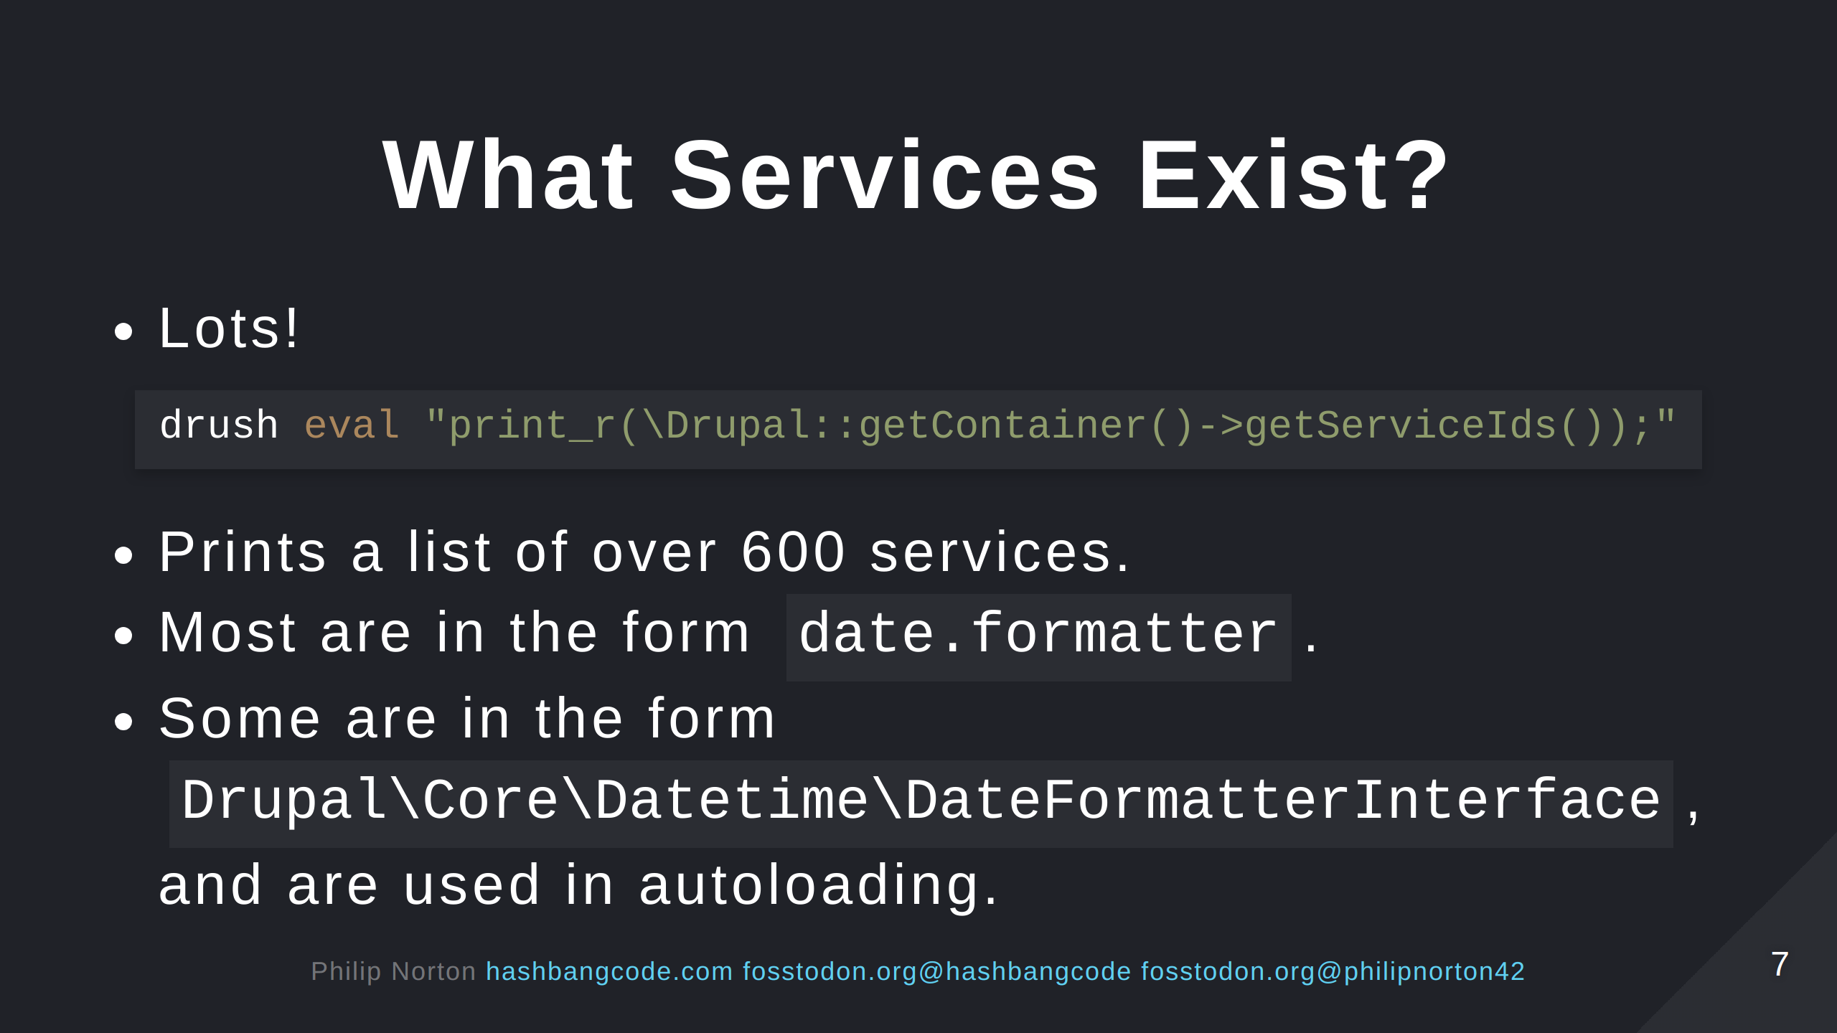
Notes:
The simple version of date.formatter is what is normal in Drupal. The interface form is used for autoloading.

Slide 8
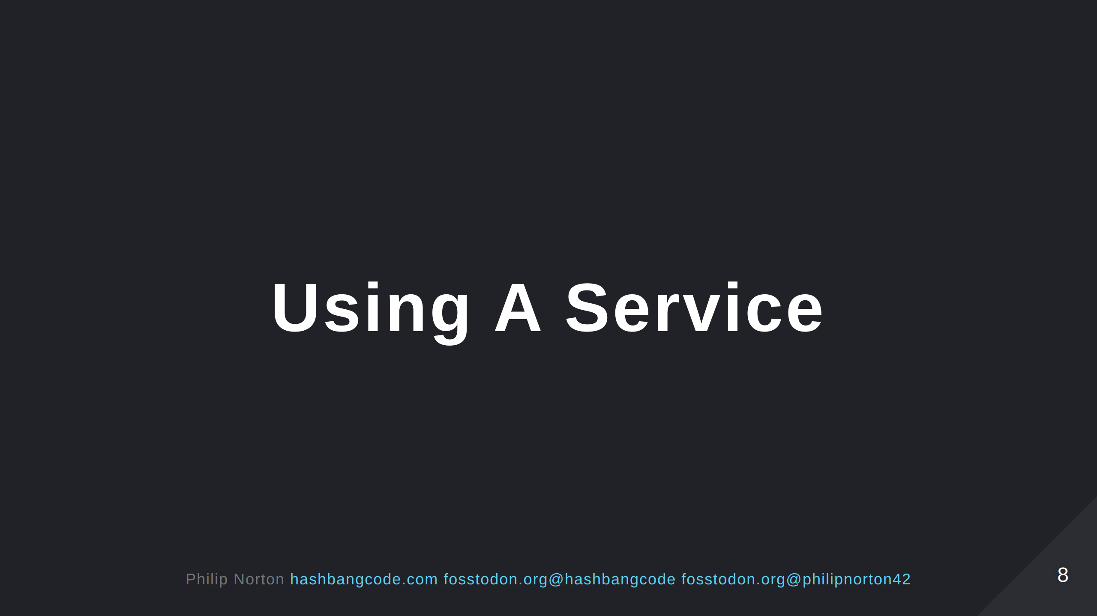

Slide 9
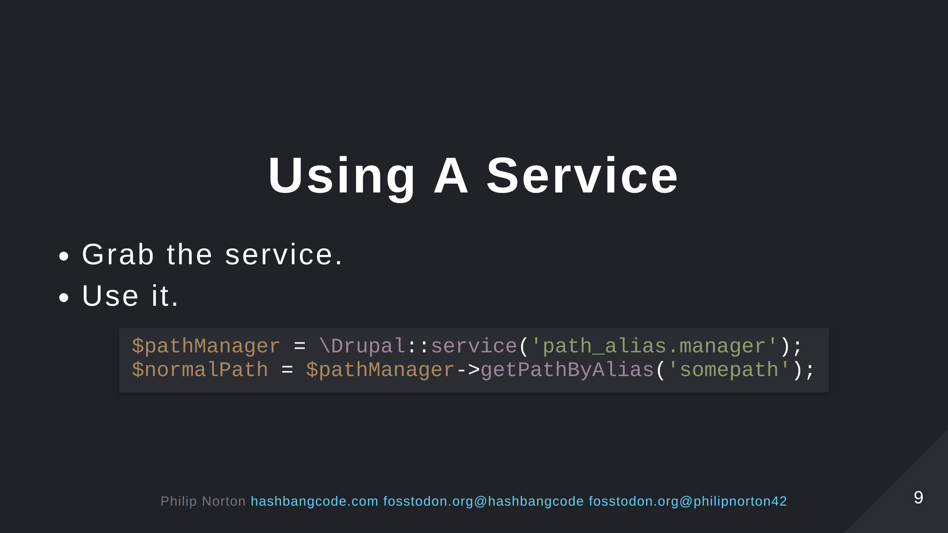
Notes:
This is the path alias manger service. The above code will convert "somepath" into a Drupal path, something like "node/123".

Slide 10
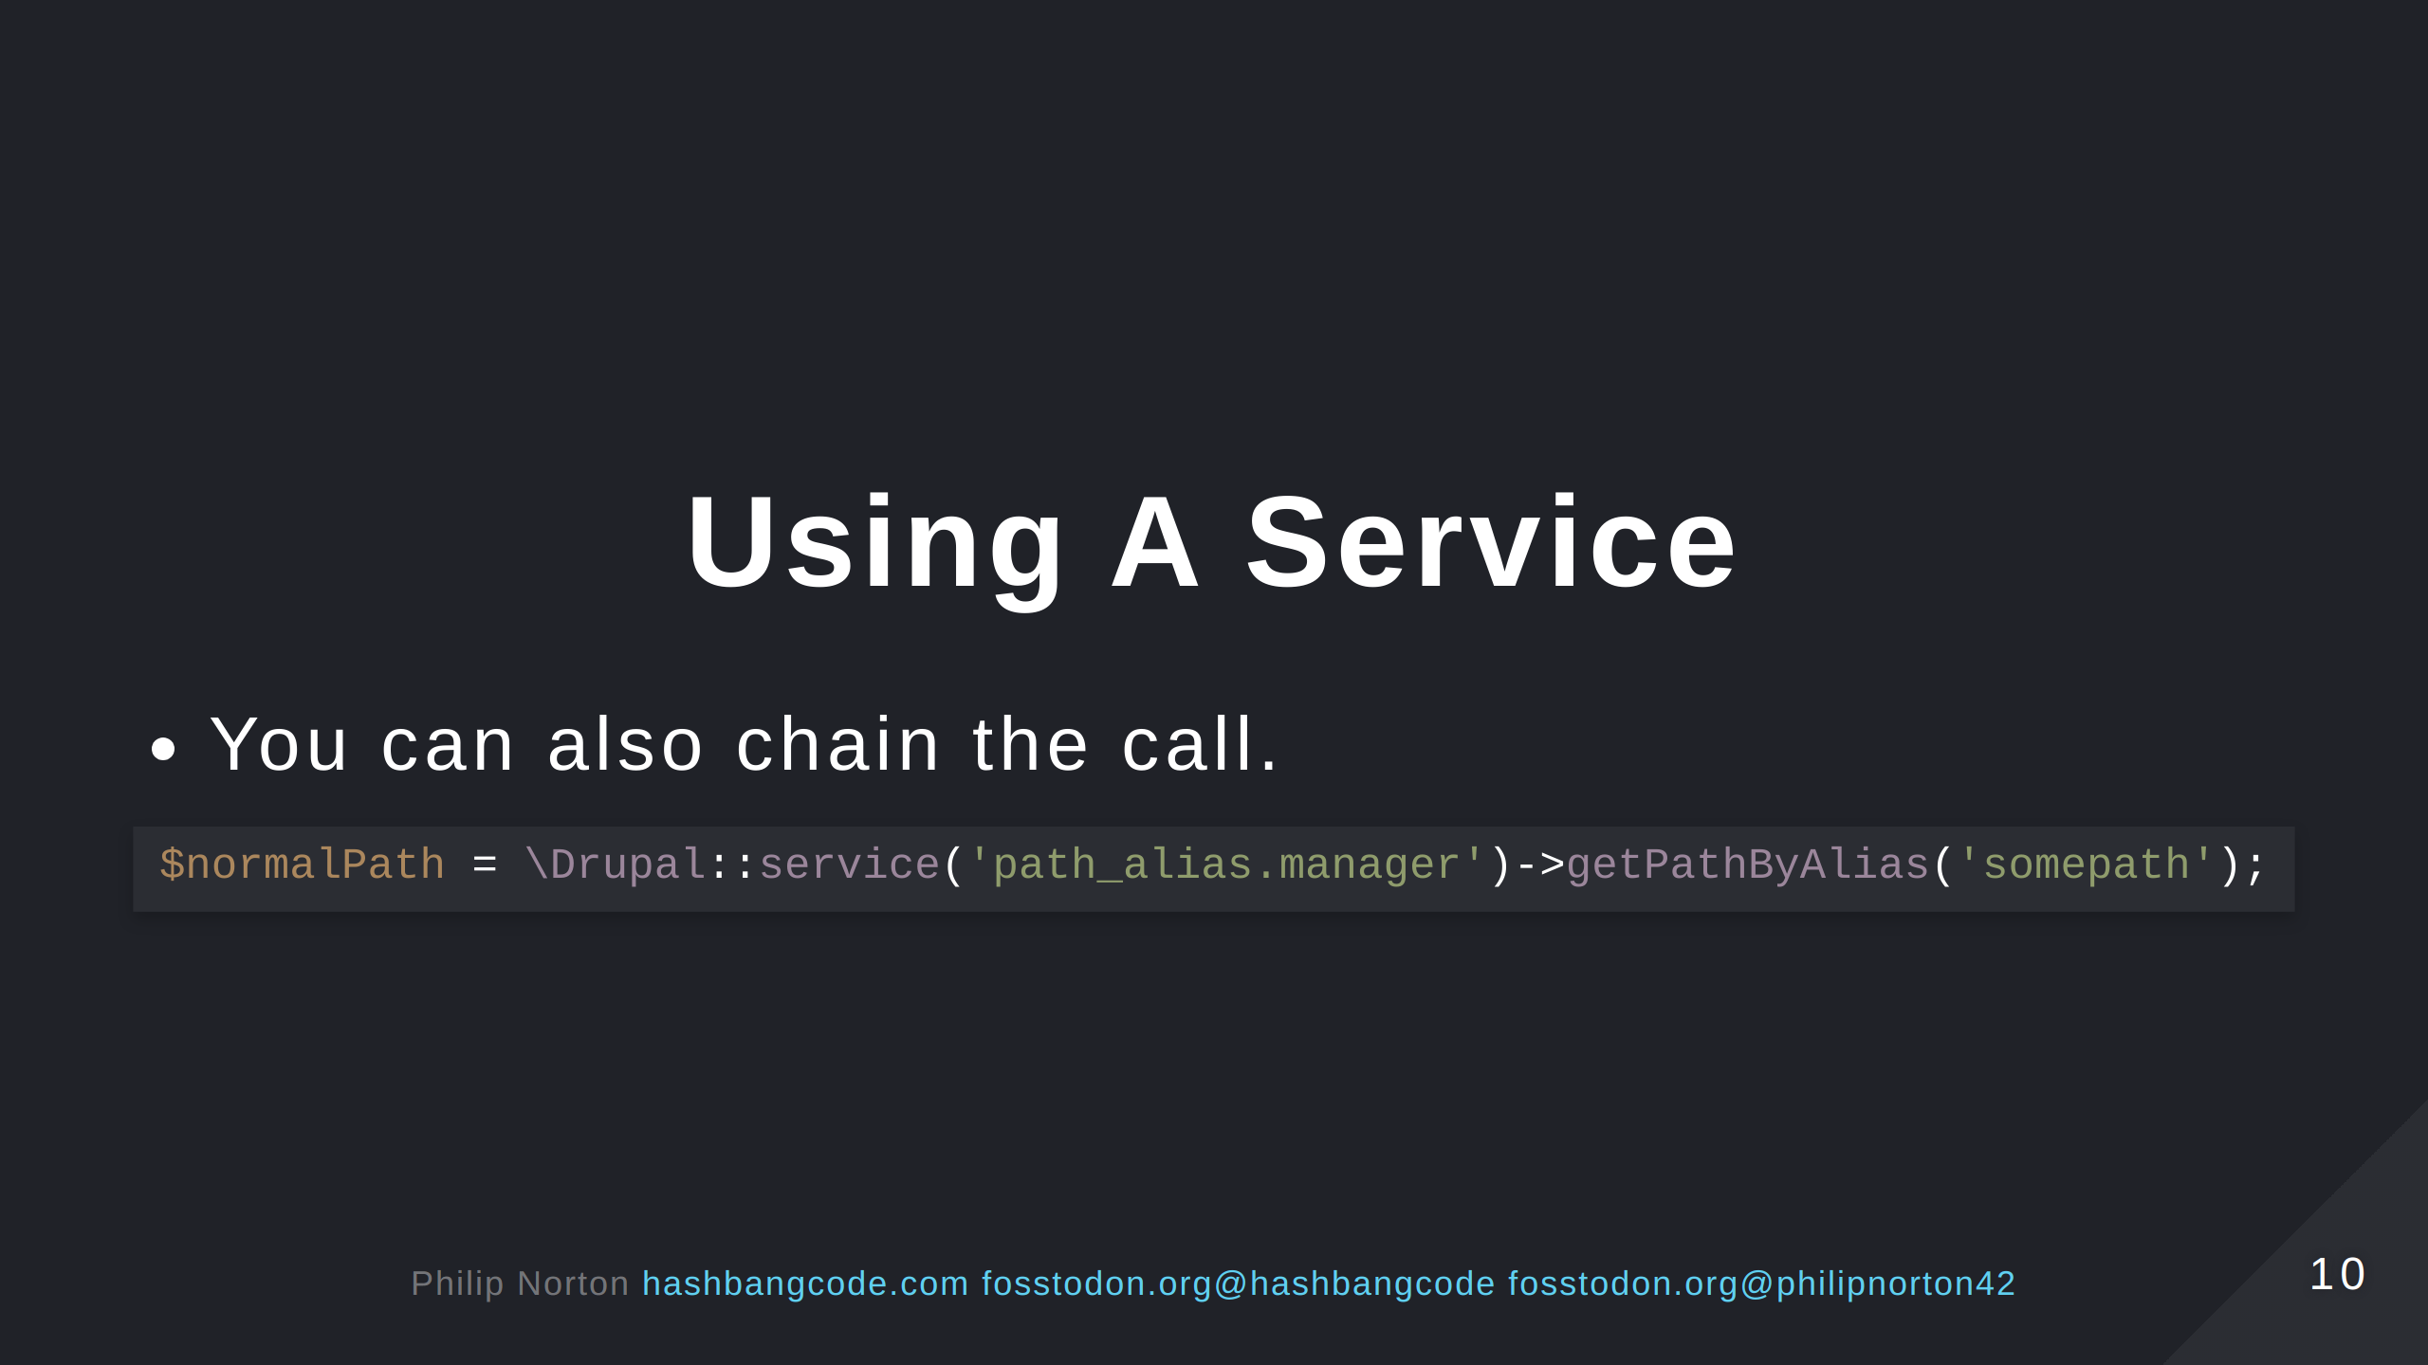

Slide 11
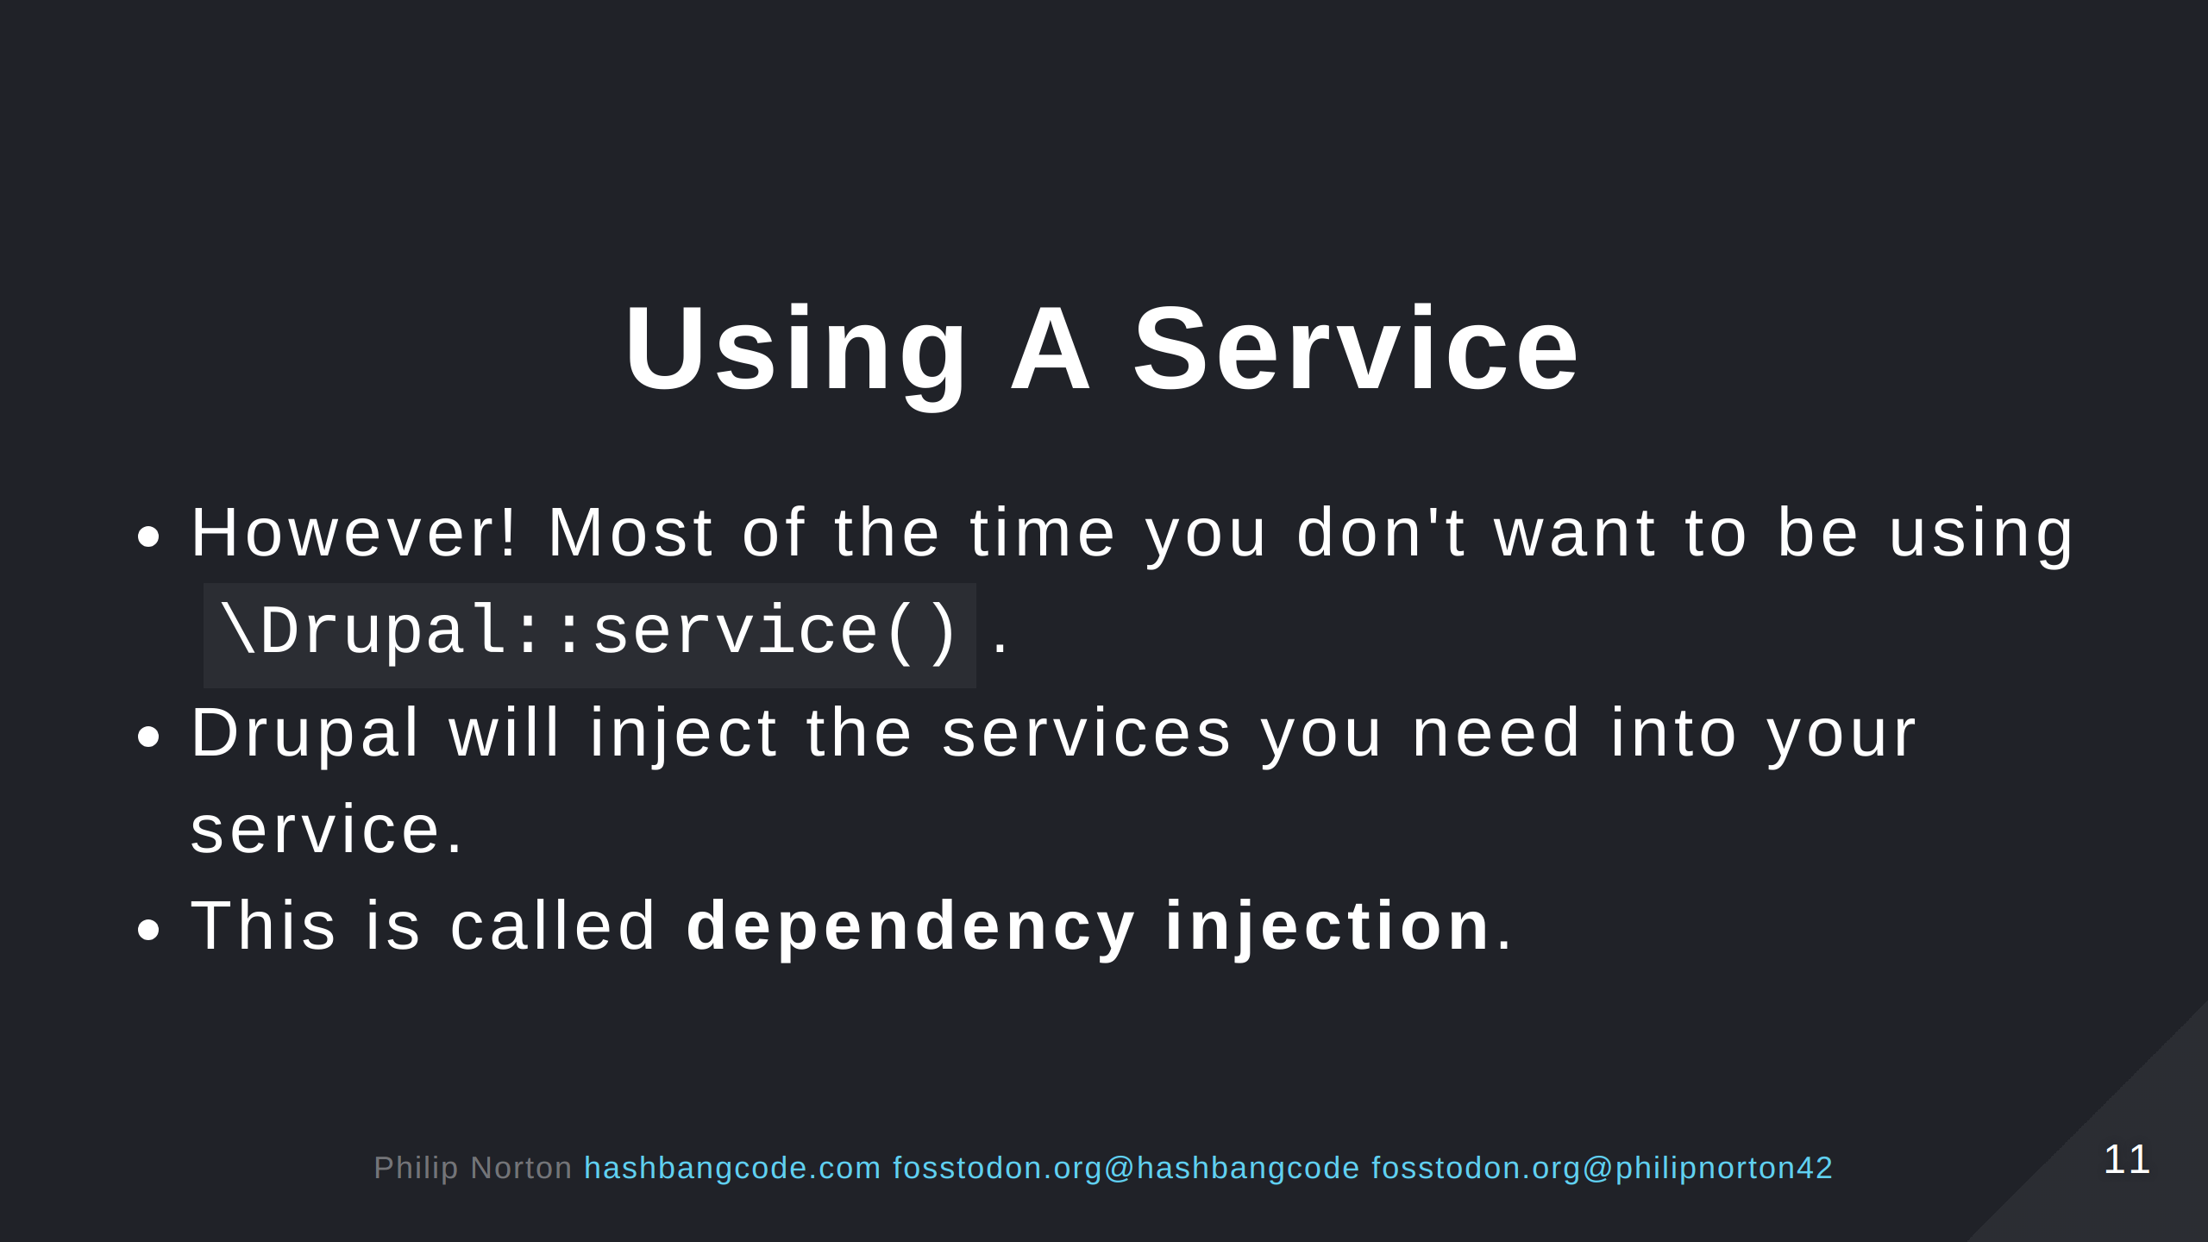

Slide 12
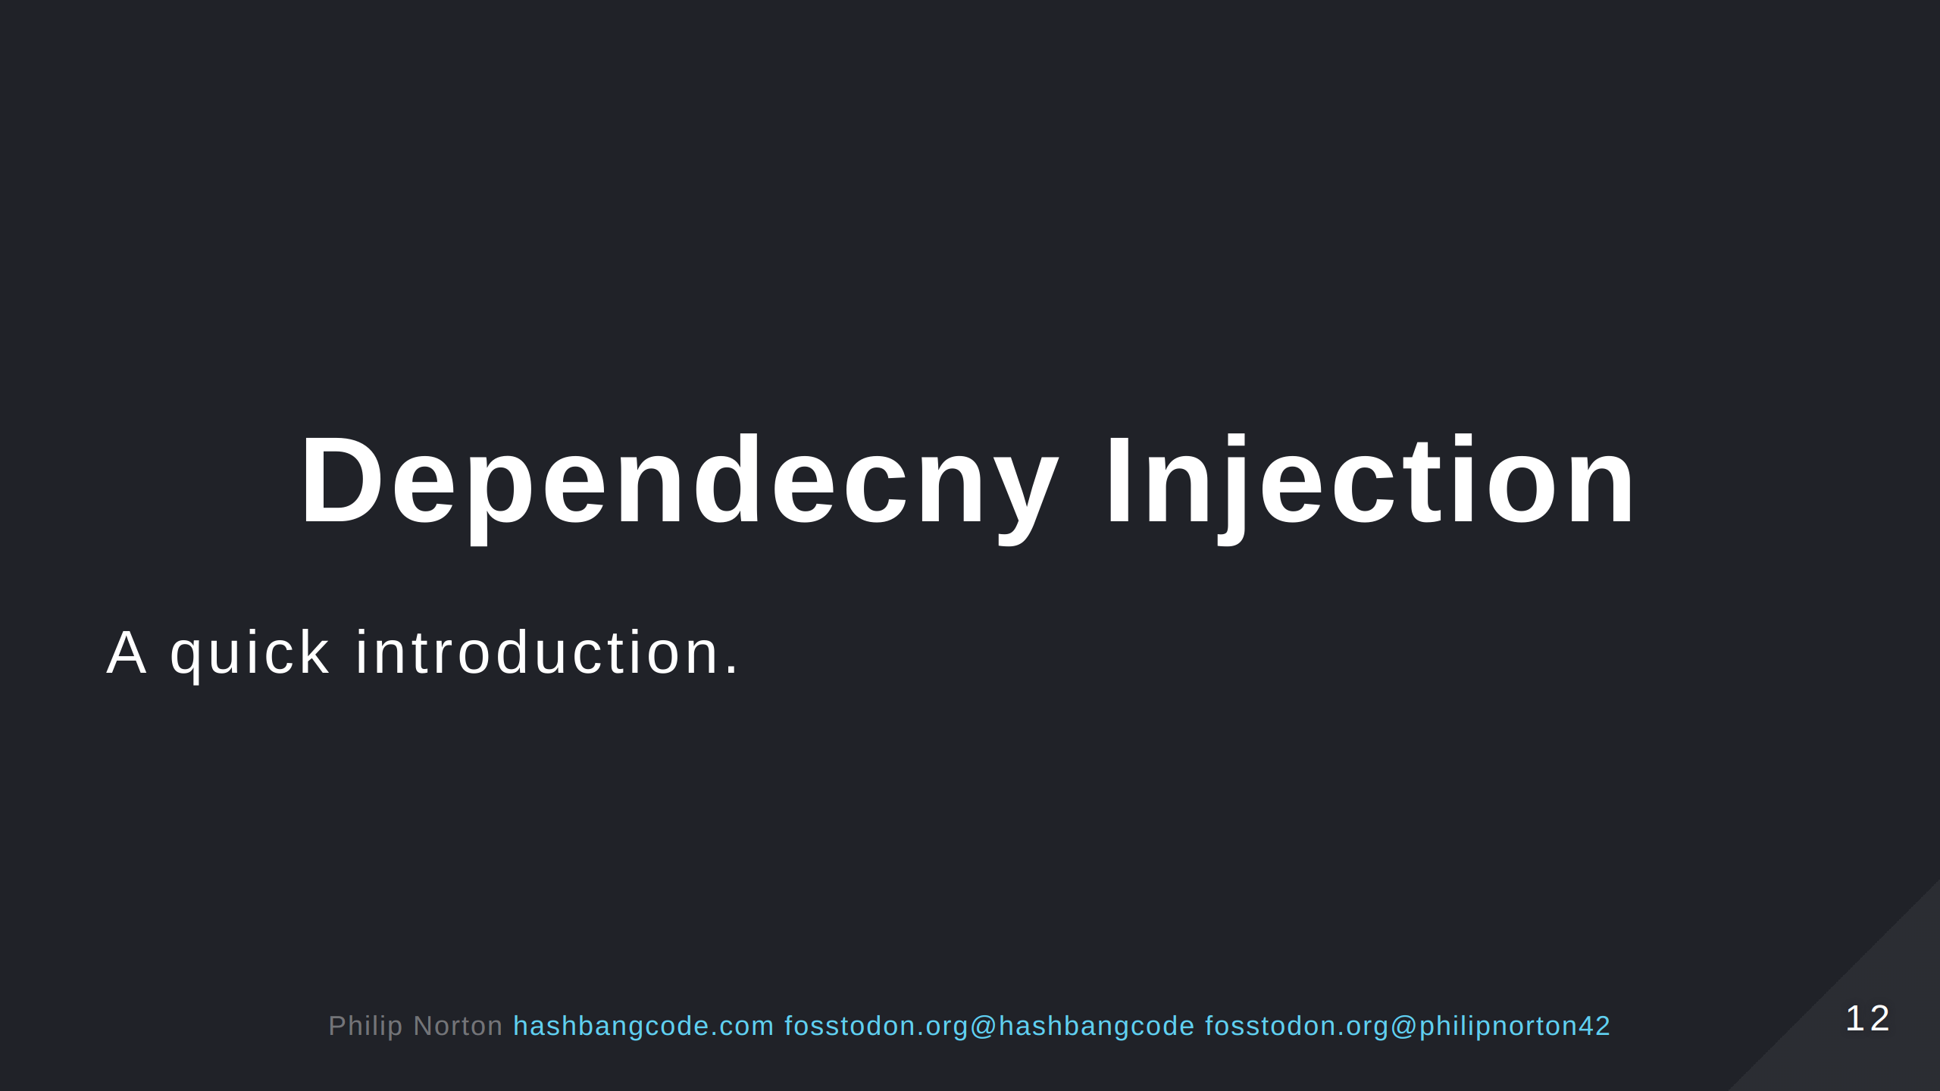

Slide 13
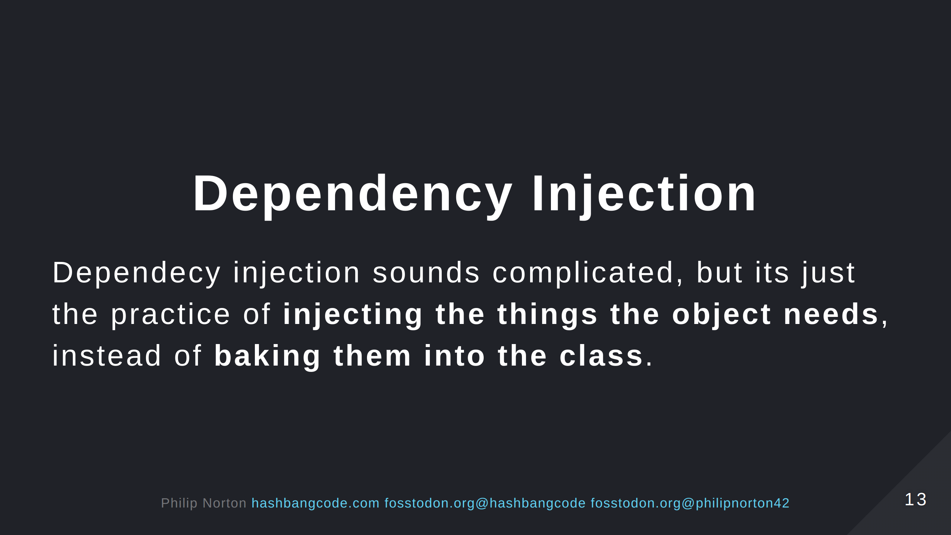
Notes:
Some OOP wording here. Make sure this is clear.

Slide 14
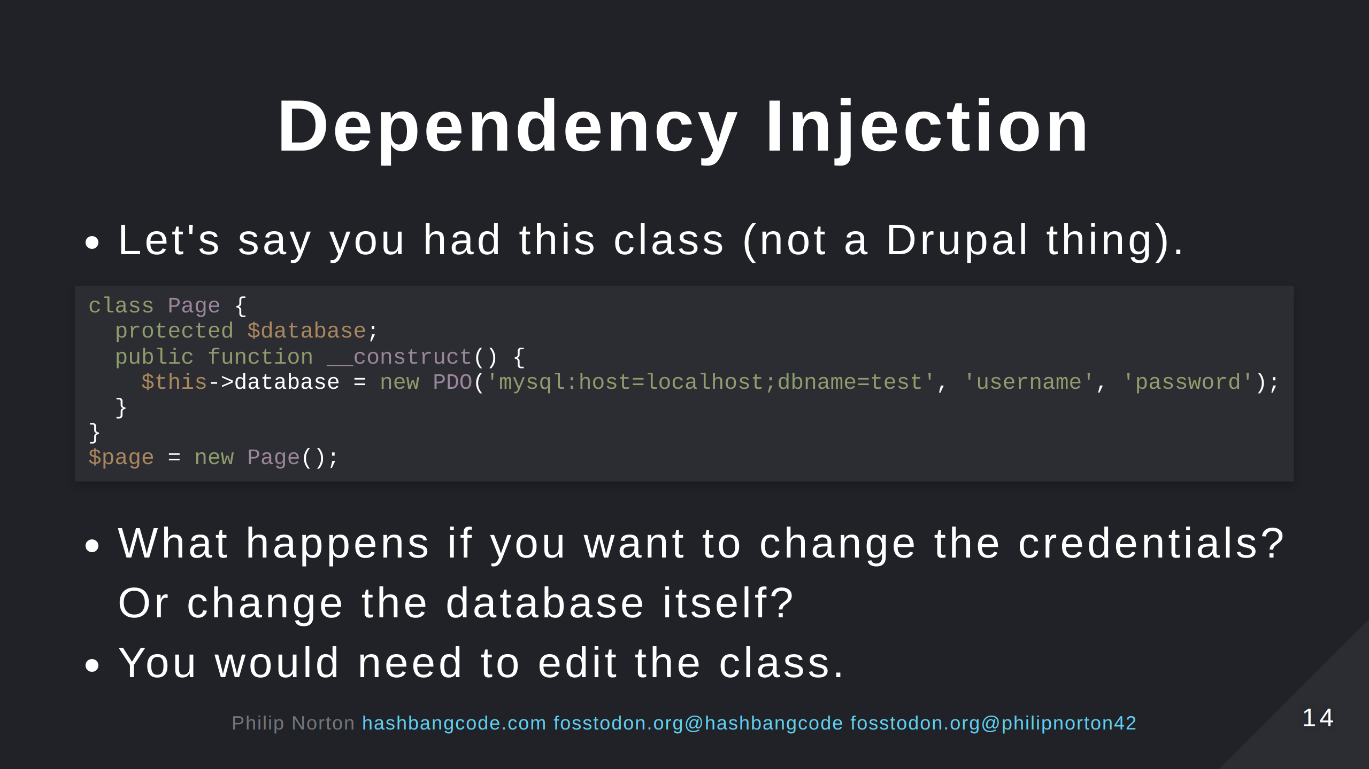
Notes:
Think SOLID principles.

Slide 15
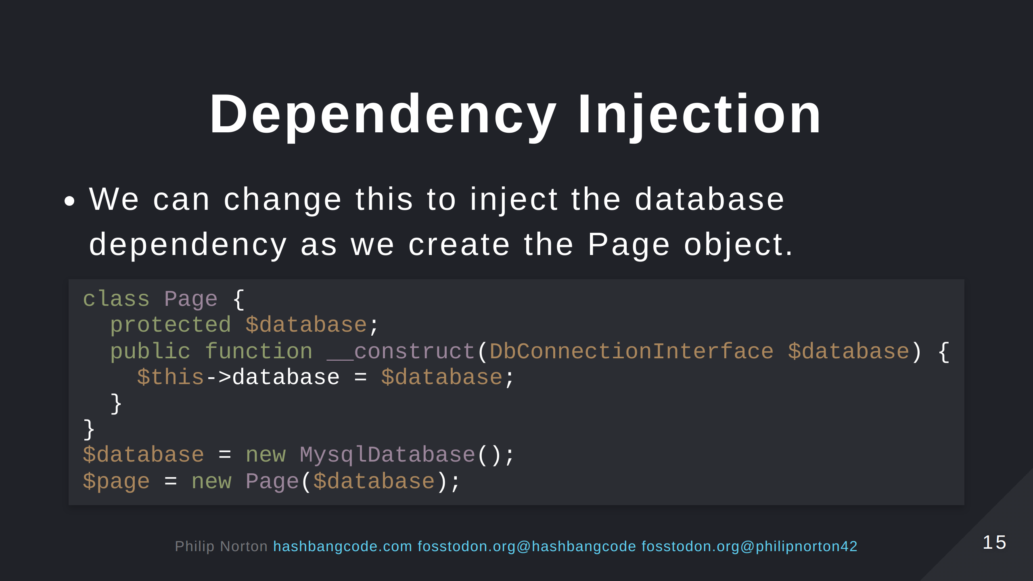
Notes:
Dependency Inversion principle.

Slide 16
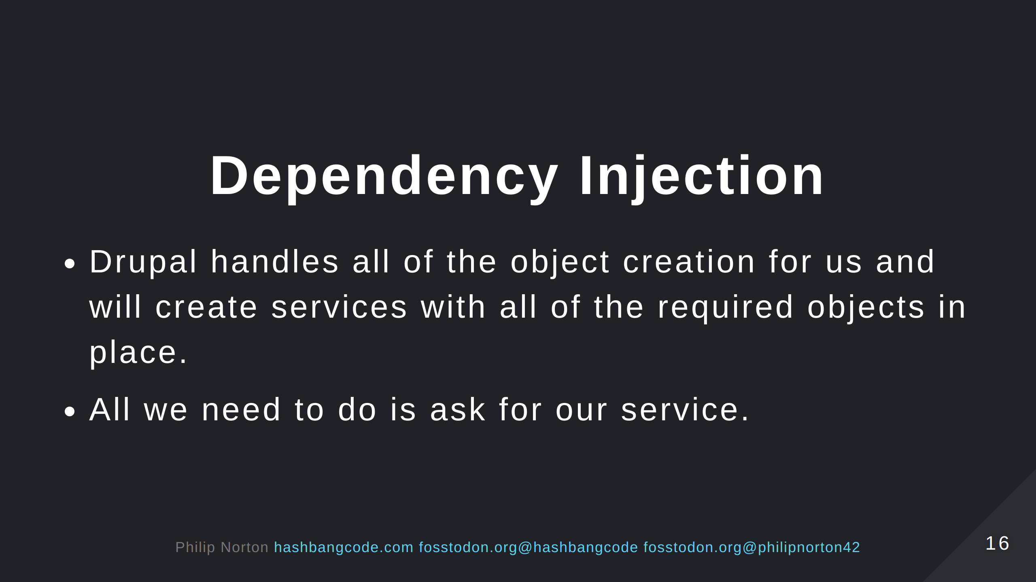

Slide 17
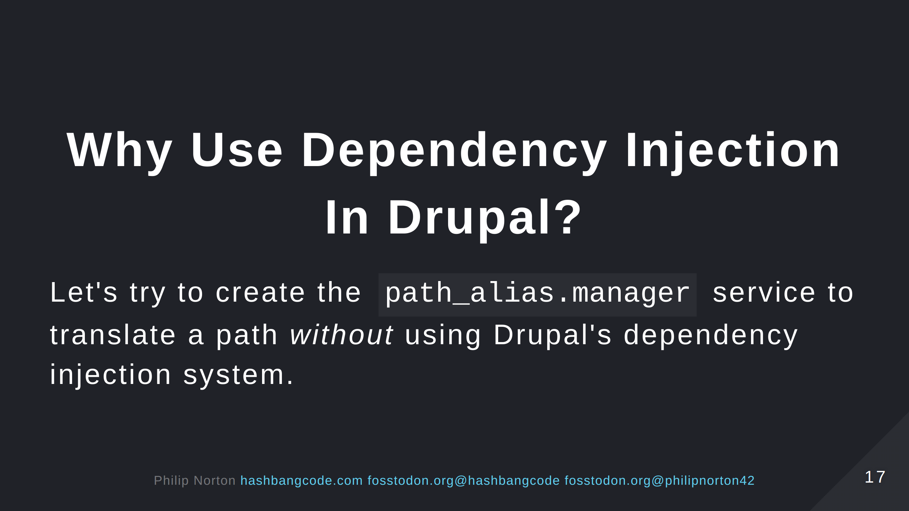

Slide 18
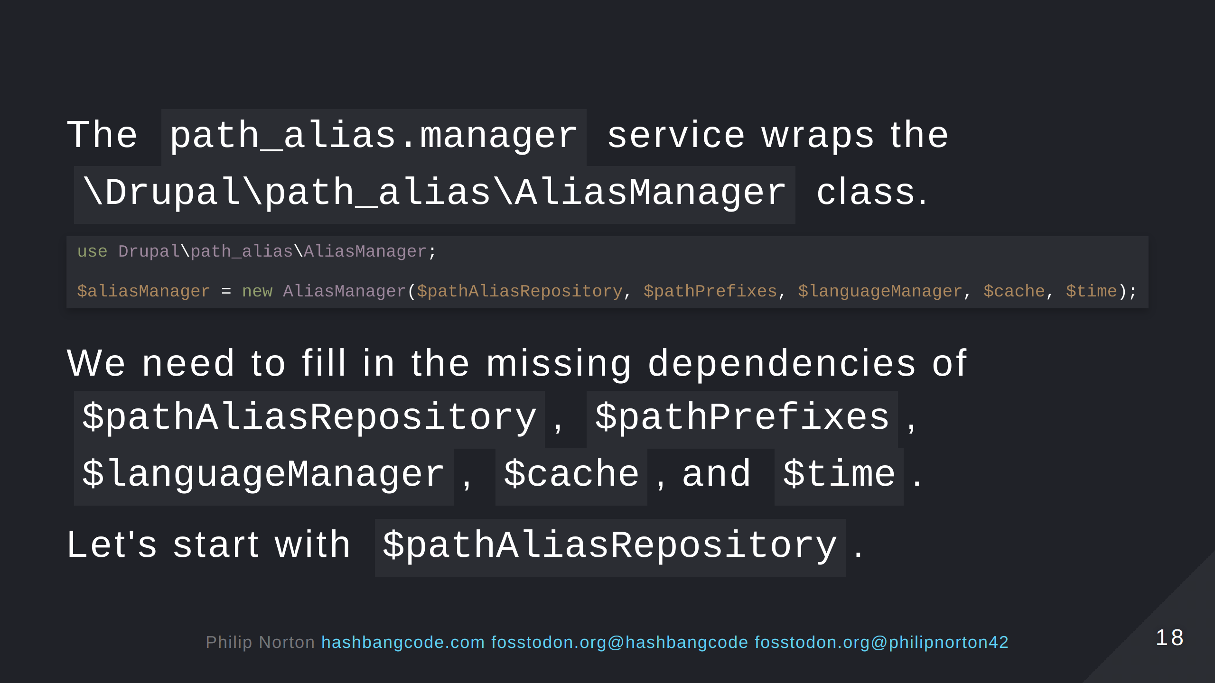

Slide 19
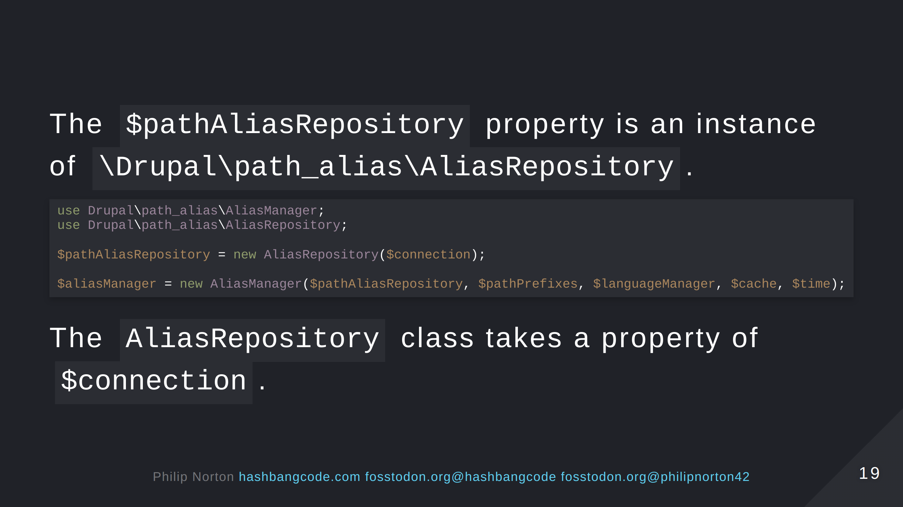

Slide 20
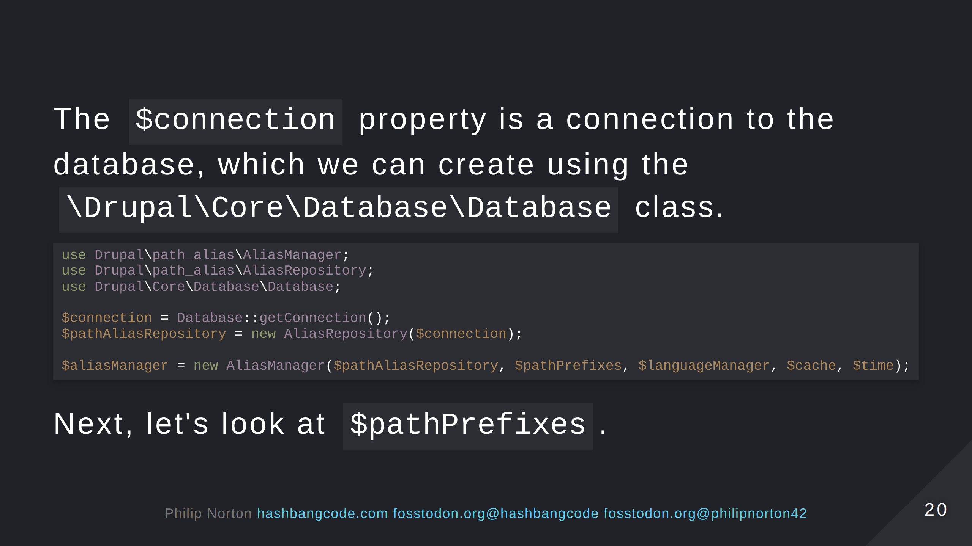

Slide 21
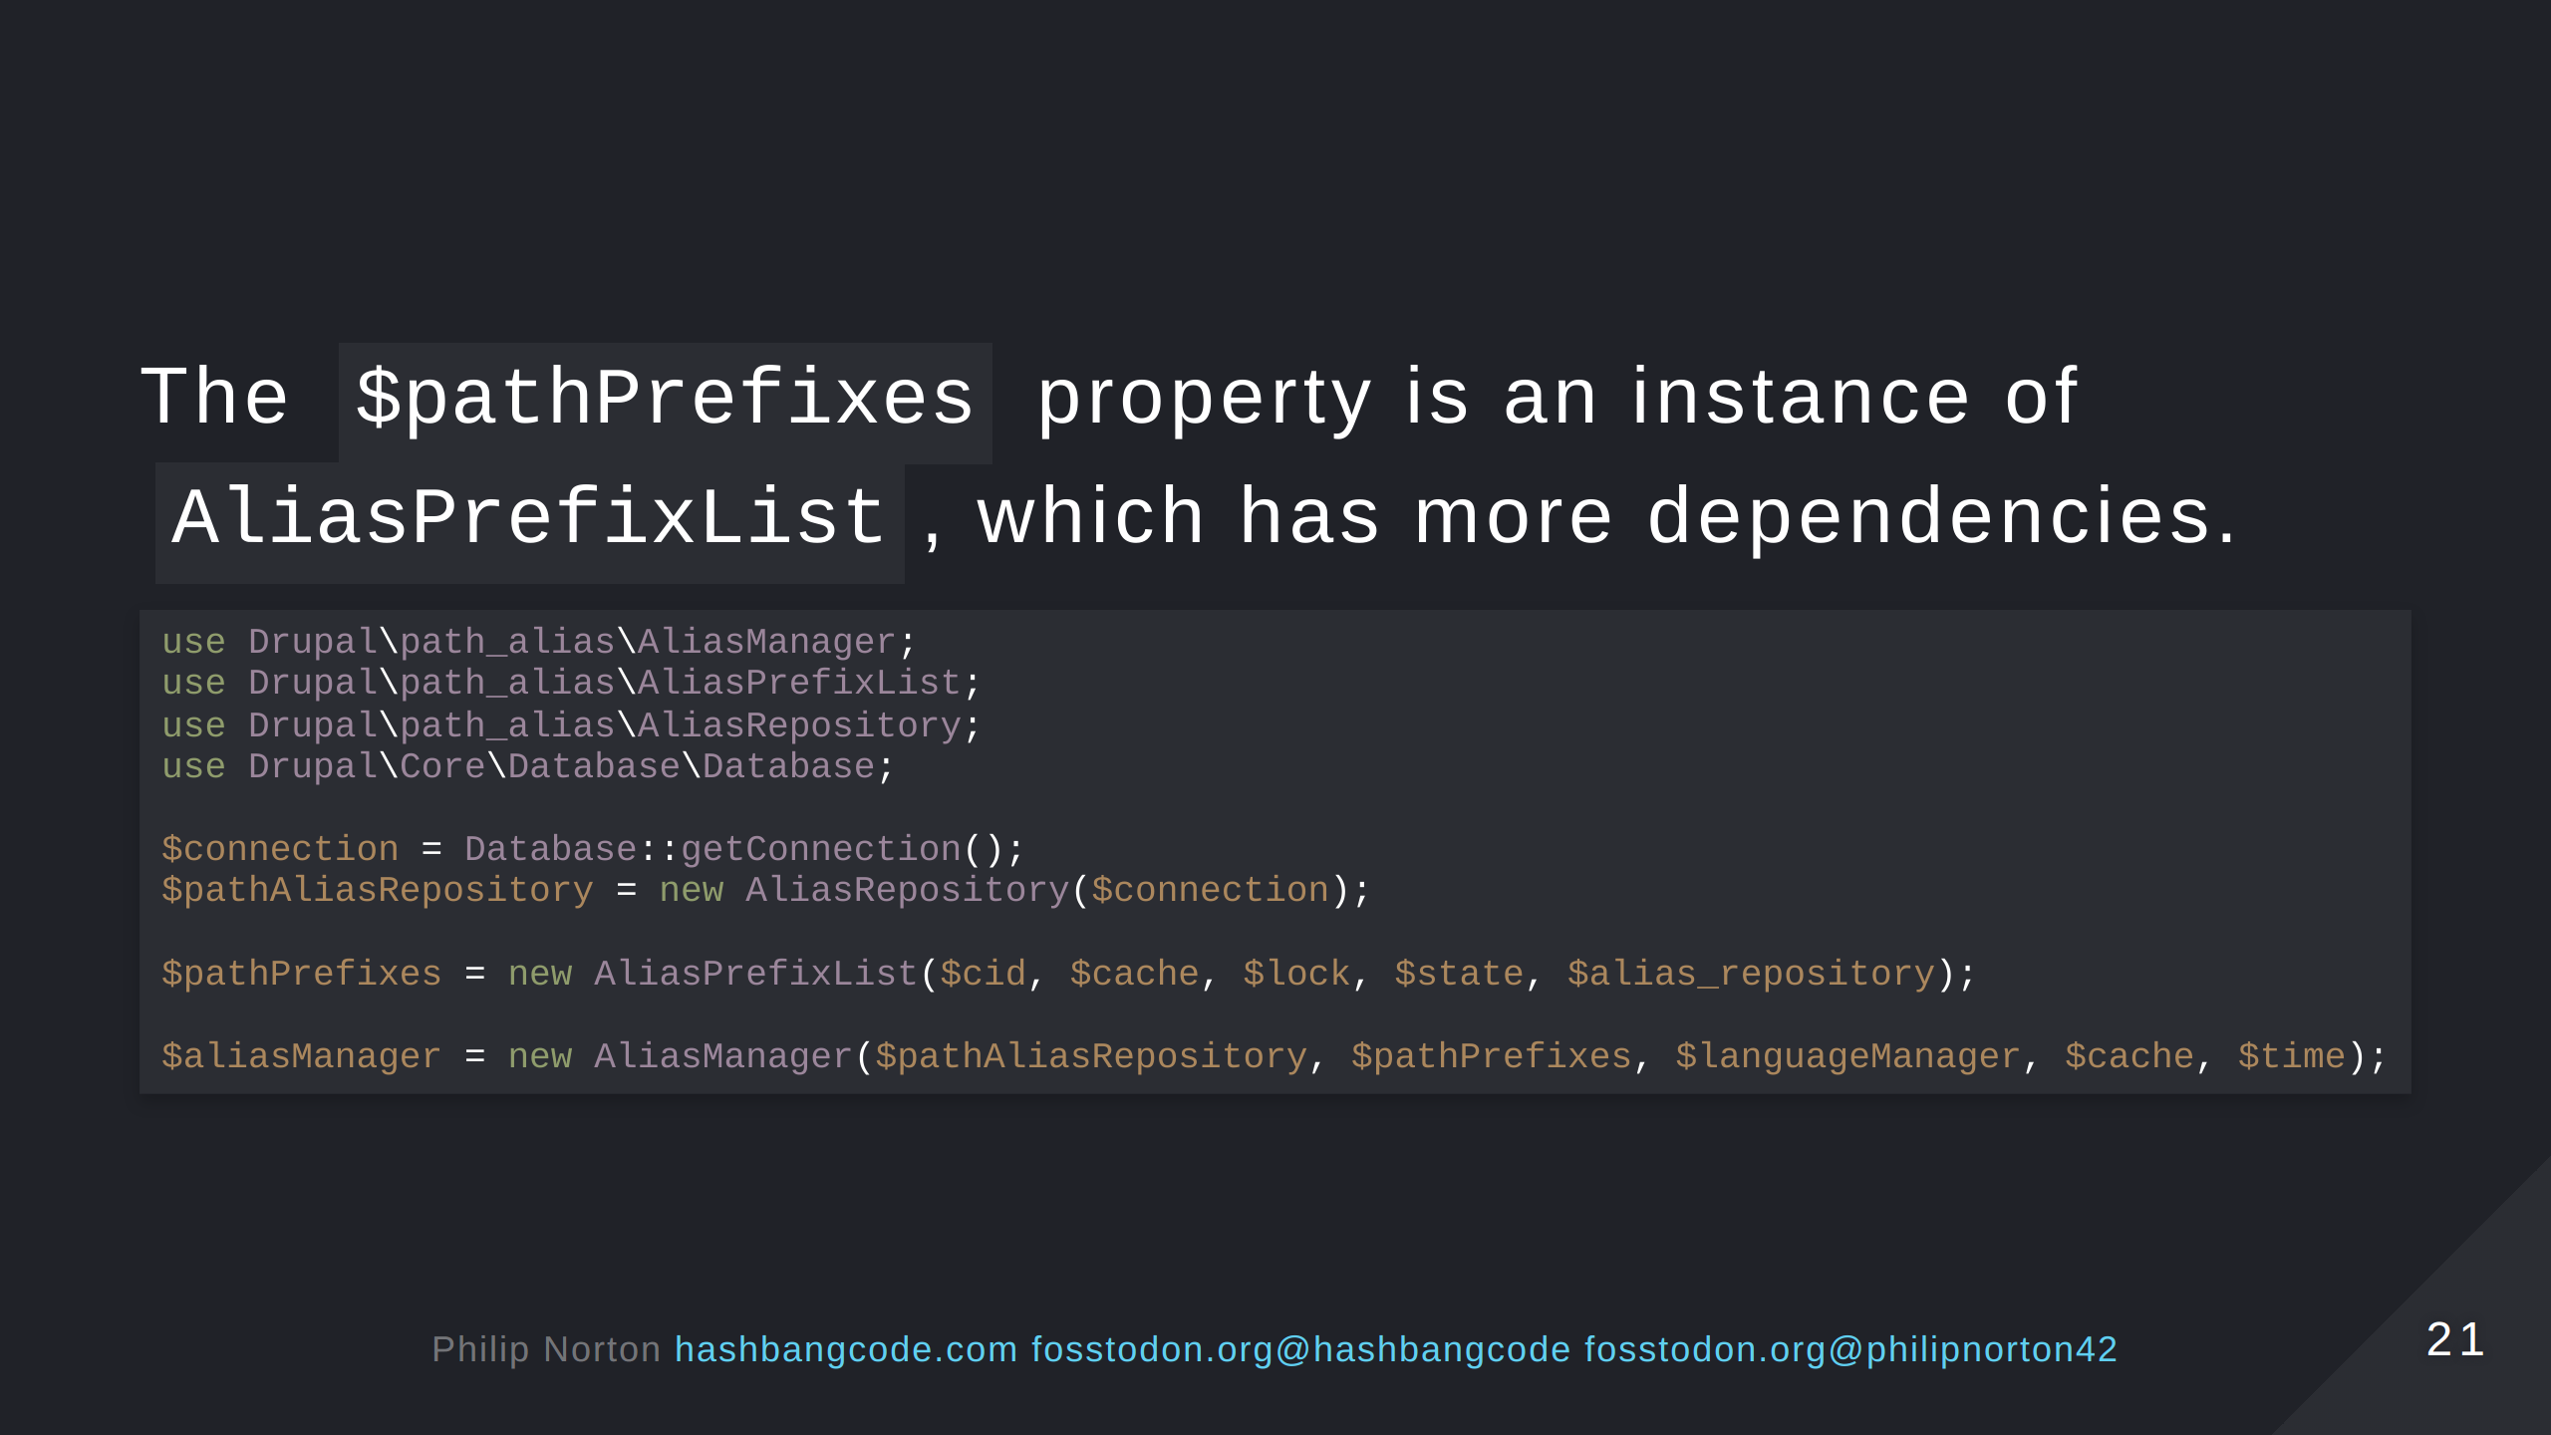
Notes:
We have made a decision here about where the data will come from. We are assuming that all the paths are stored in our local database. Which is an ok assumption to make, but this is how hard coded.

Slide 22
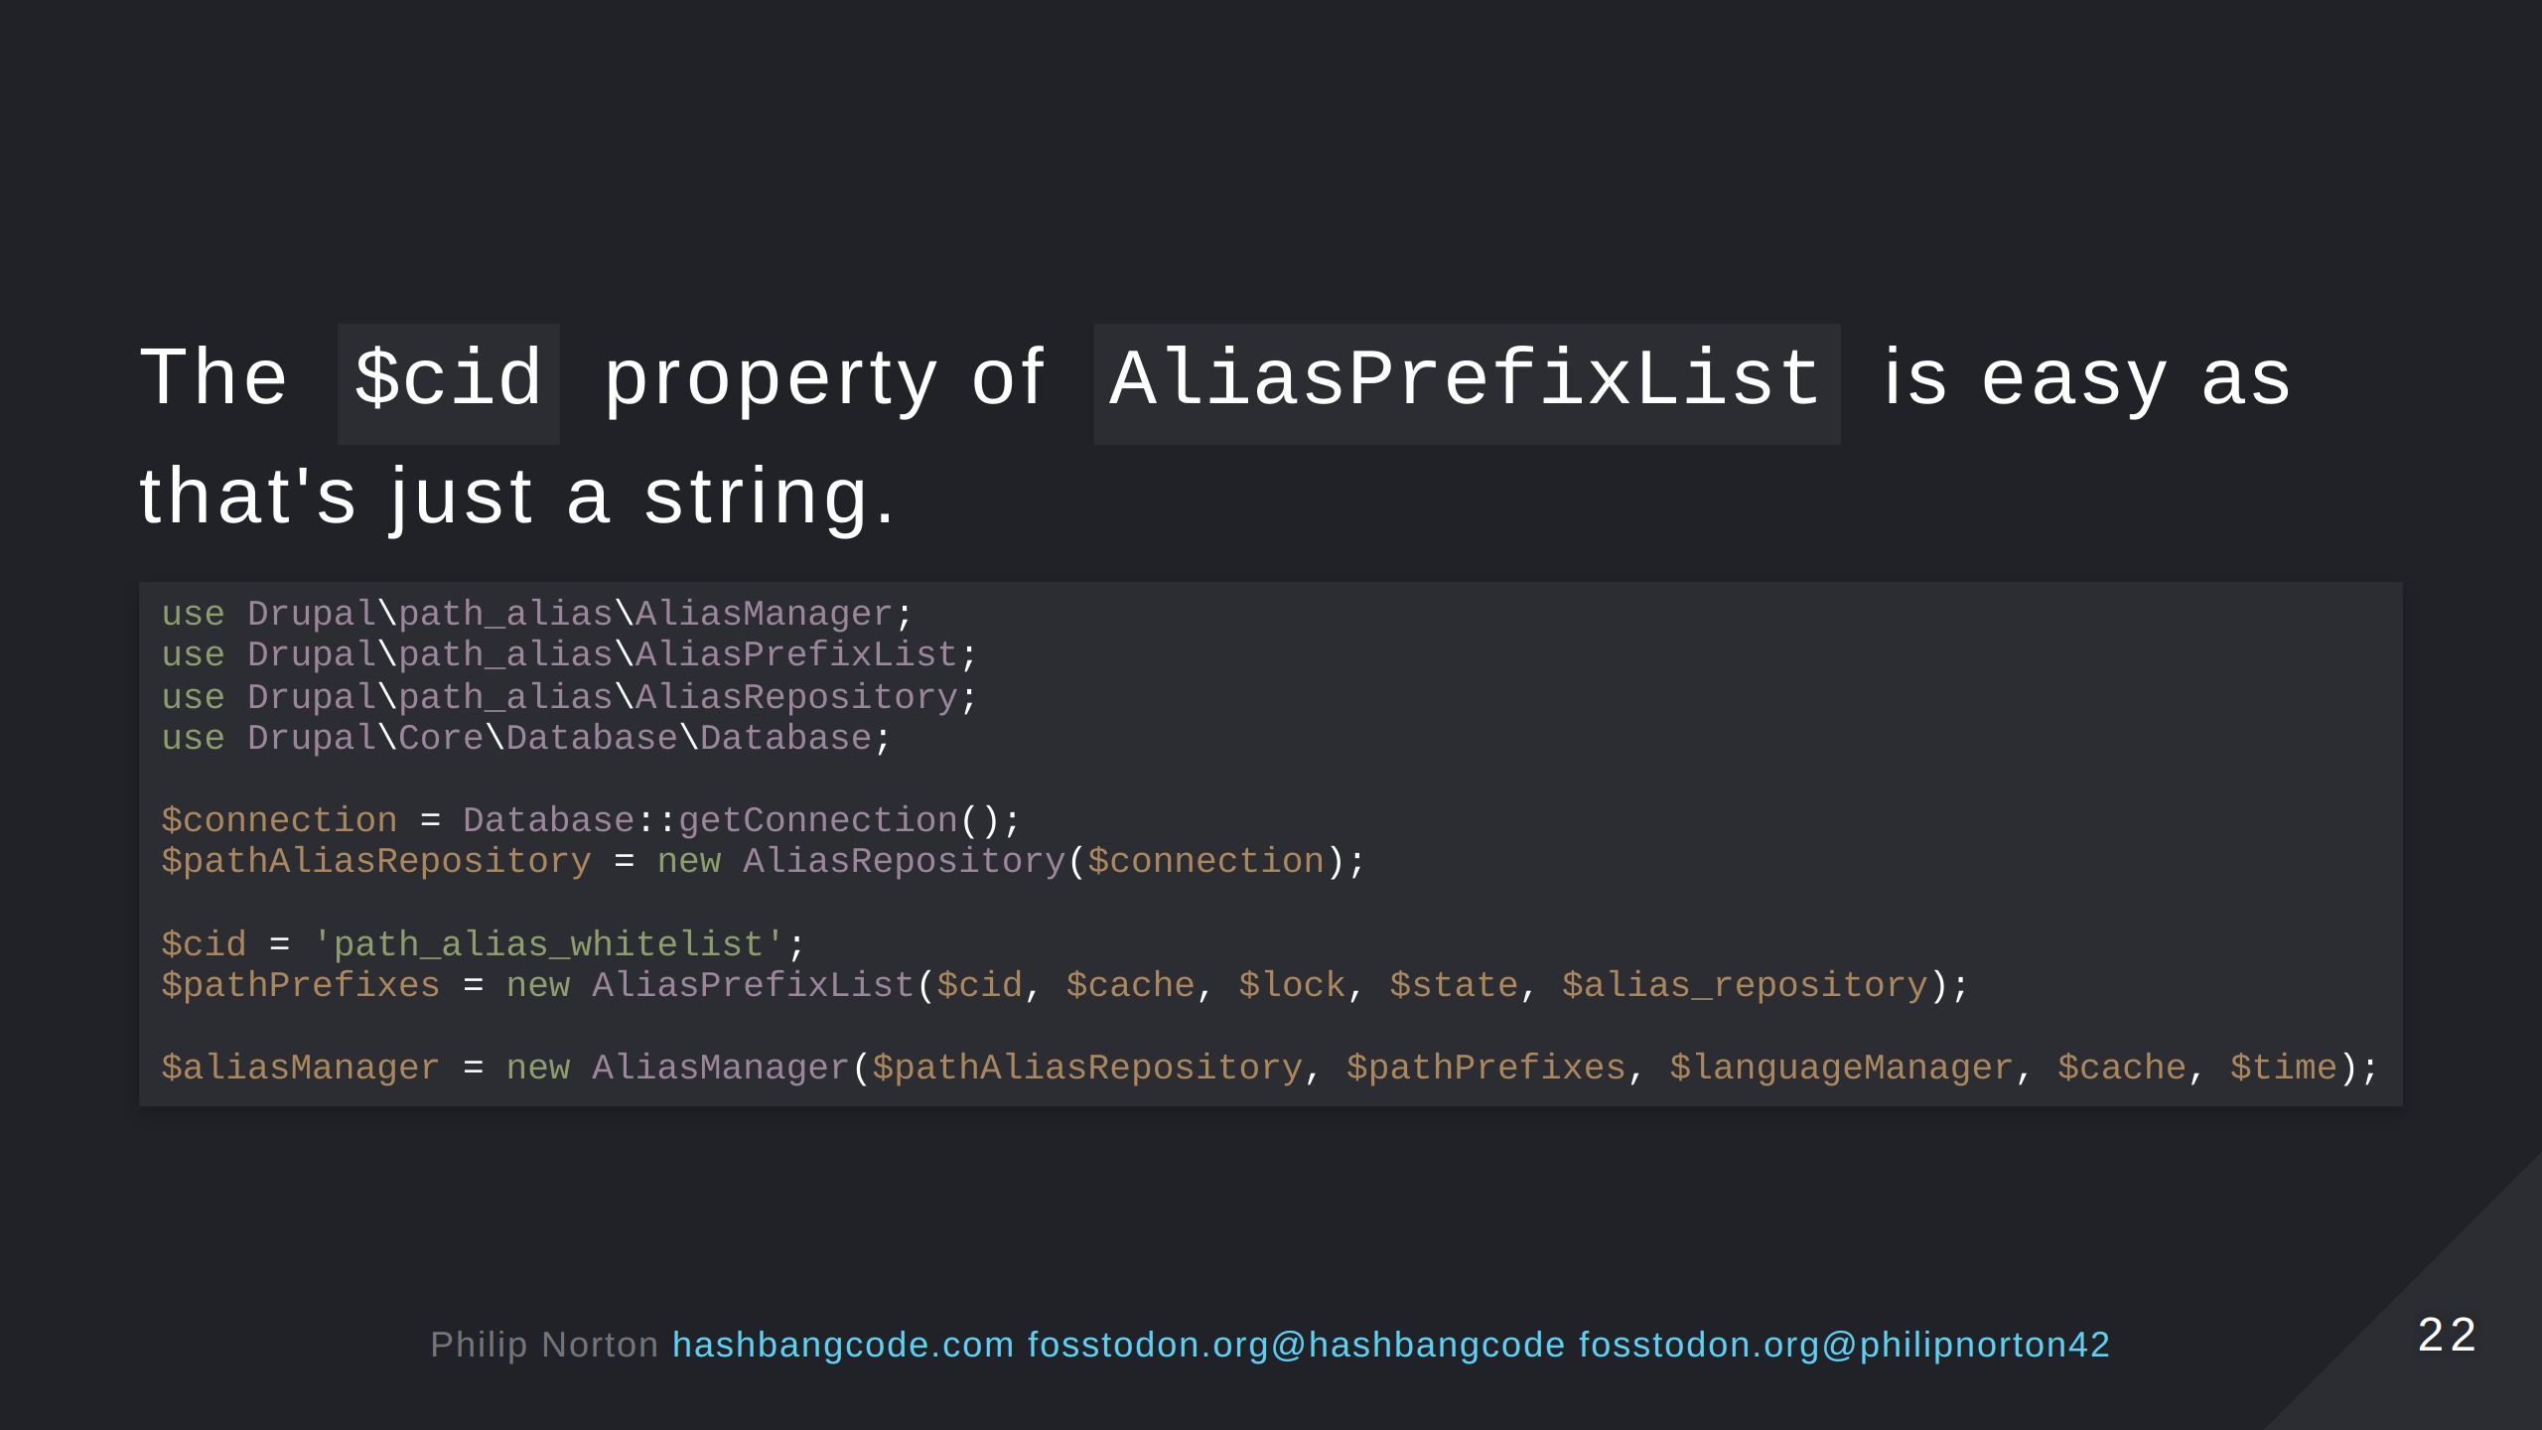

Slide 23
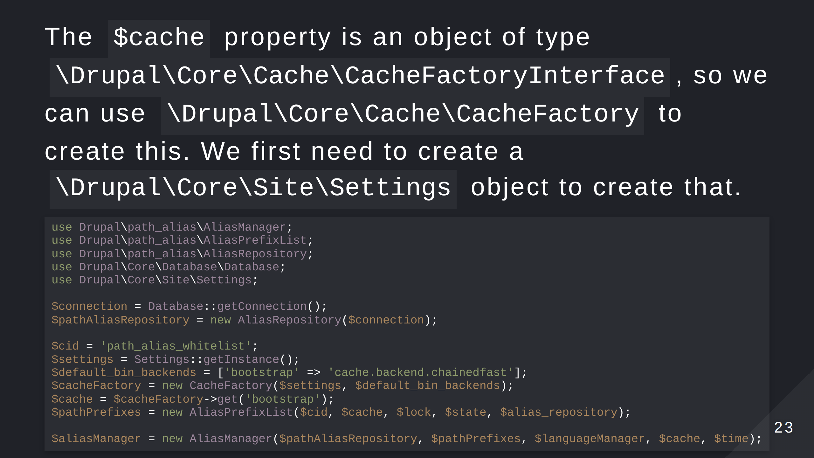
Notes:
We have now made several assumptions about our settings, the type of cache we will use, where the cache bin is stored. This has created very brittle code that is prone to breakage. Also, we still have another 3 properties to do just to get AliasPrefixList created! All of which will need objects creating, and some of those objects will have more objects, some of which might need extra stuff adding. Then, there's more properties we need to load for AliasManager! We are only half way through creating objects. Worse, every time you want to transform a path you'll need to copy this entire block of code.

Slide 24
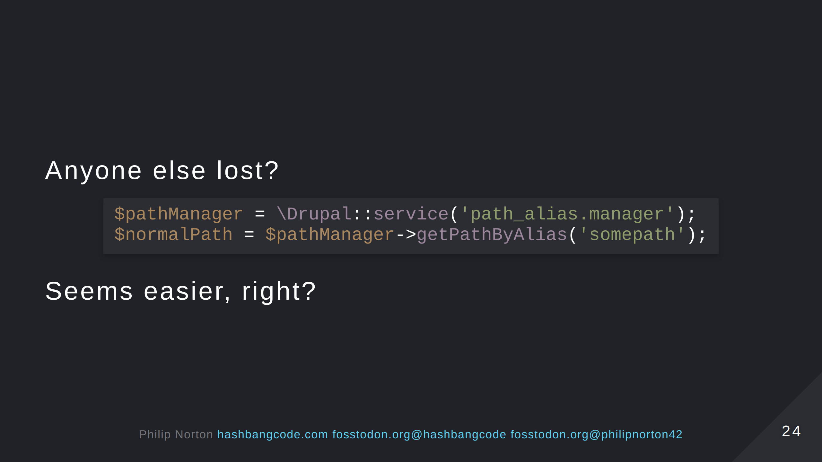

Slide 25


Slide 26
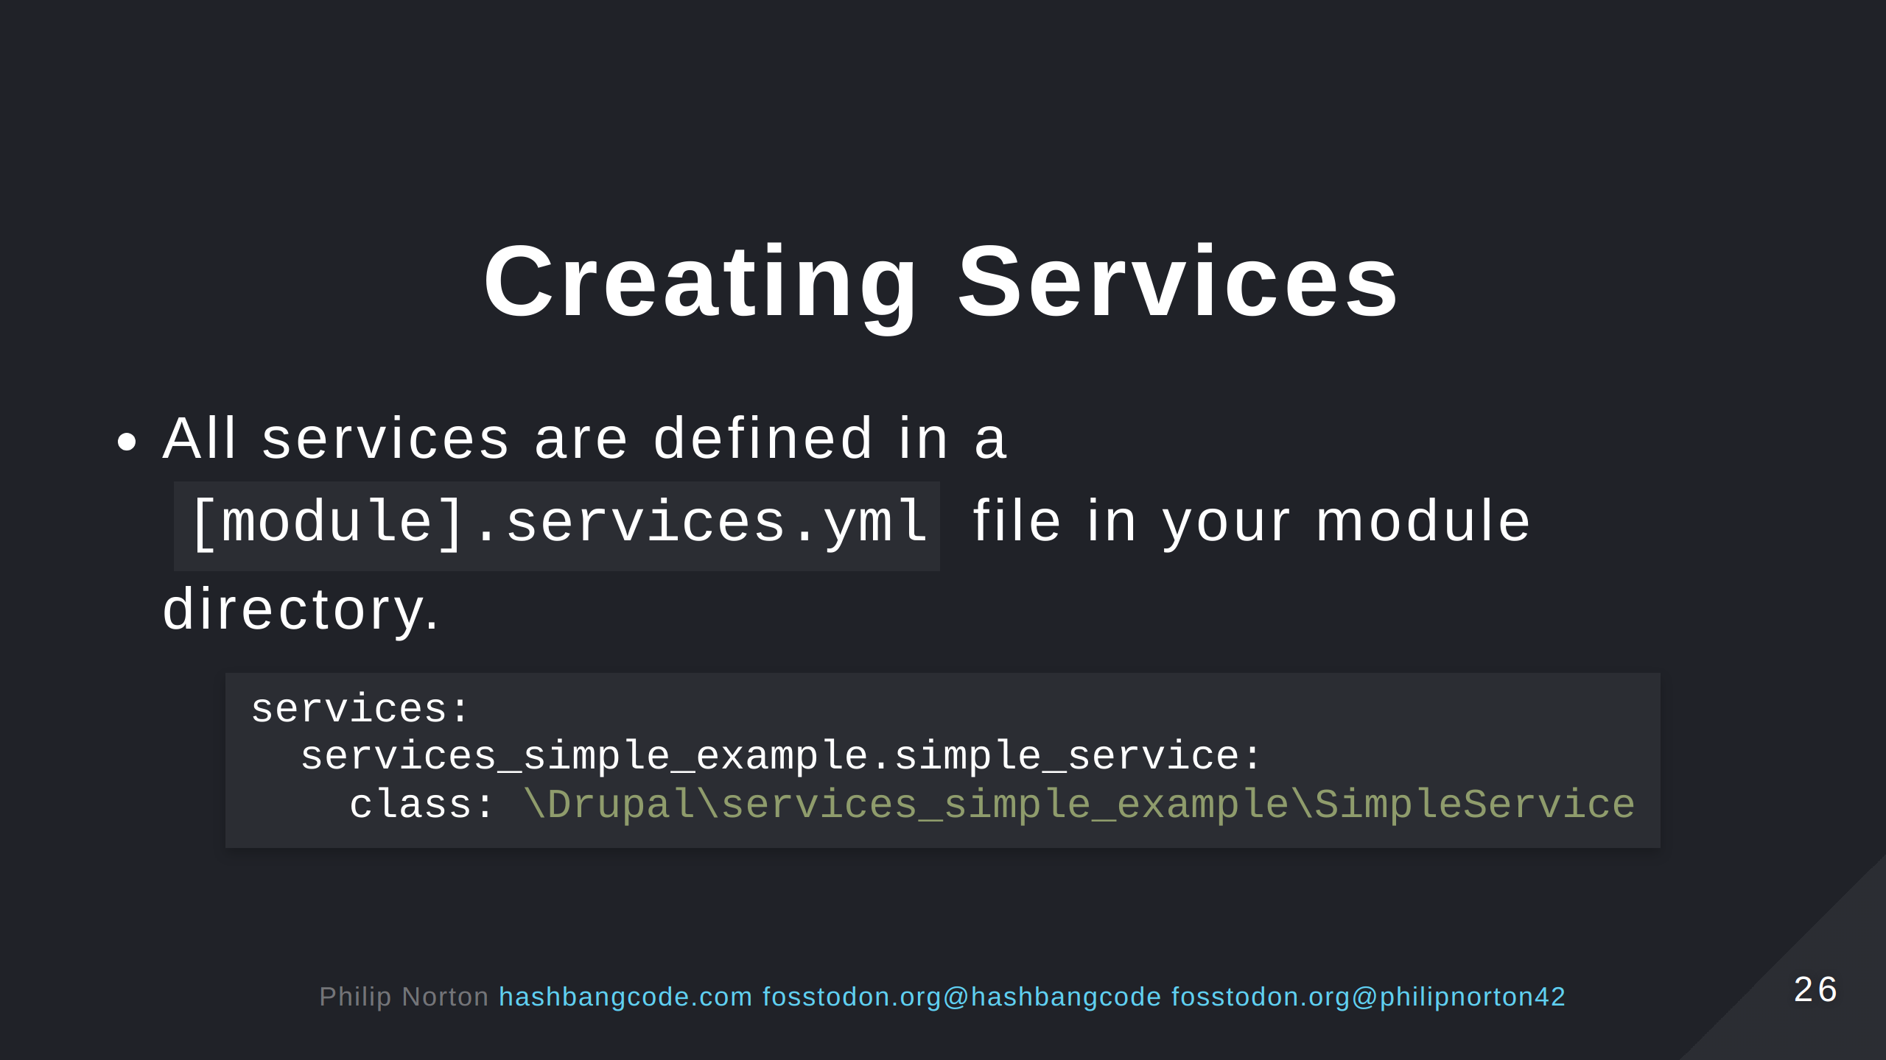

Slide 27
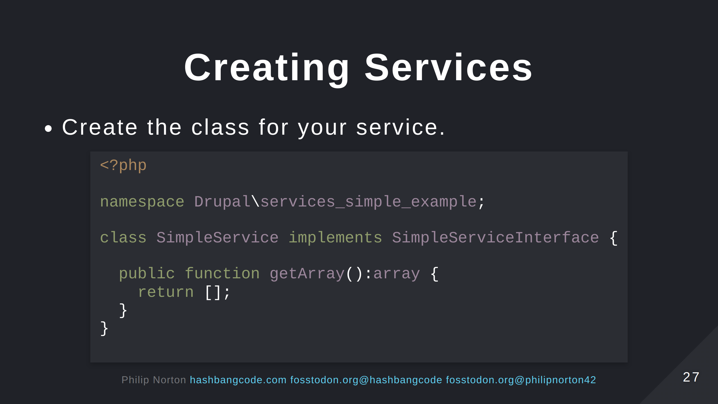

Slide 28
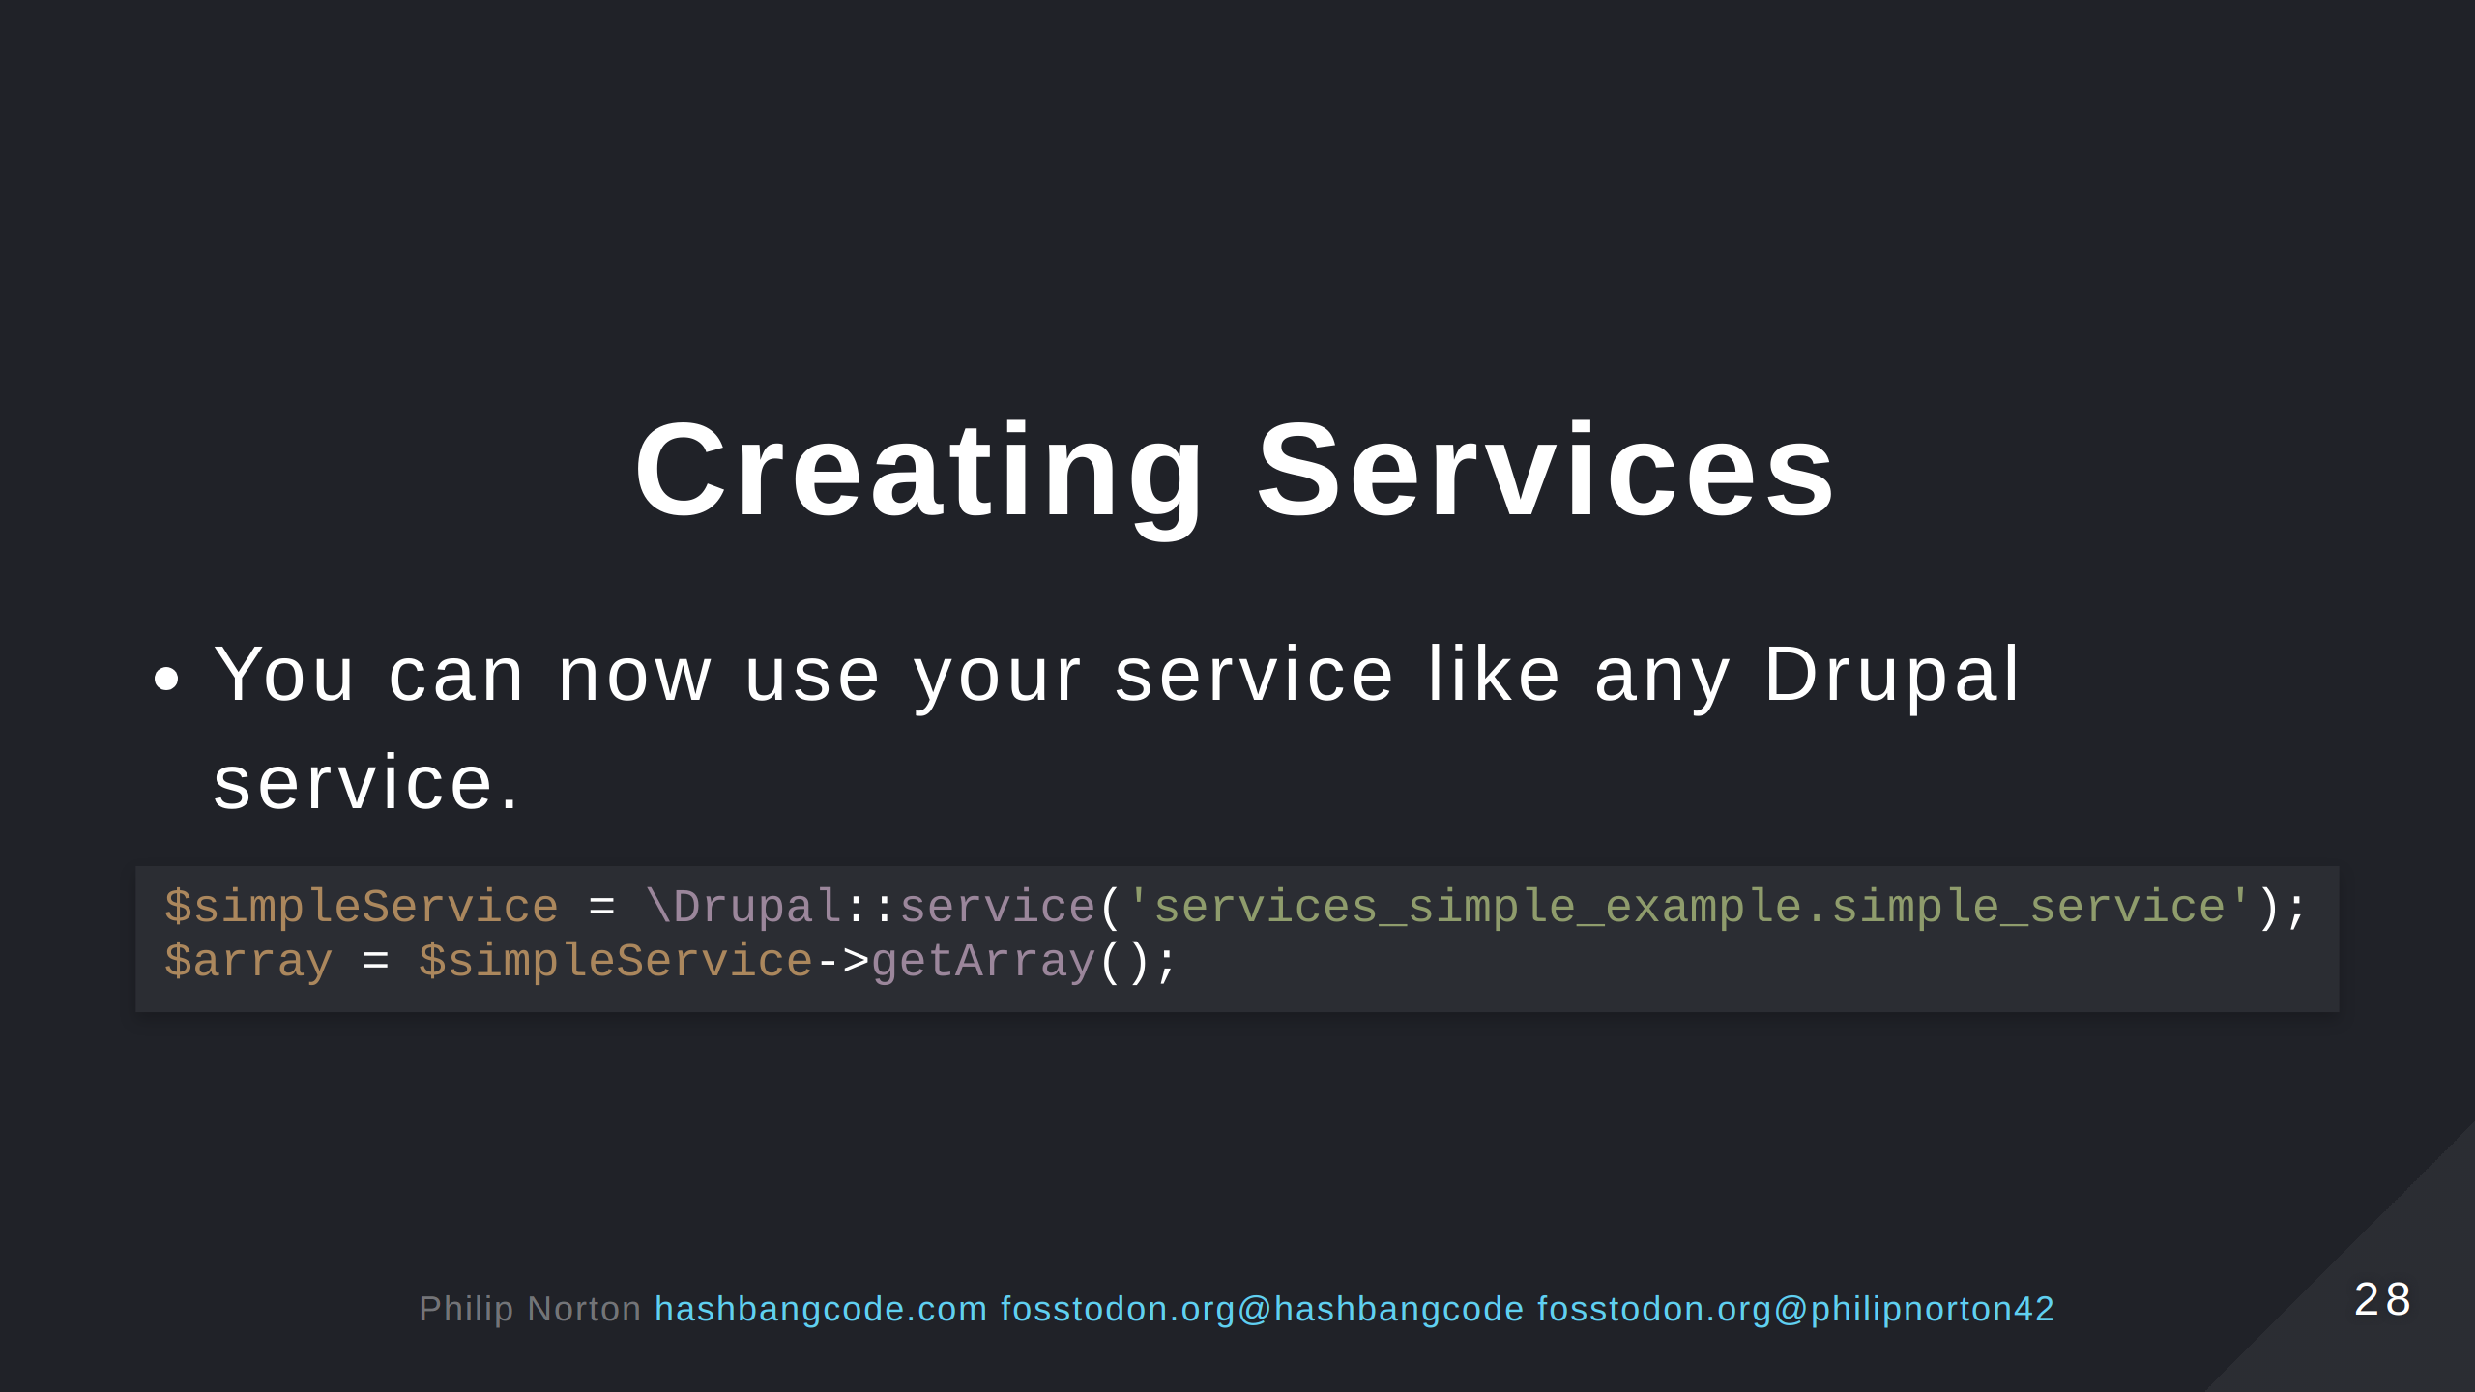

Slide 29
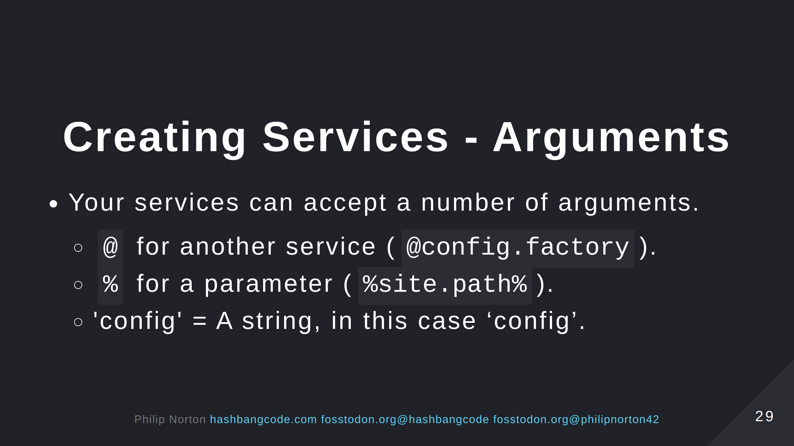
Notes:
Parameters are set in services files, but can be overridden at runtime by Drupal. Strings are used to pass static properties to factories to generate different types of object.

Slide 30
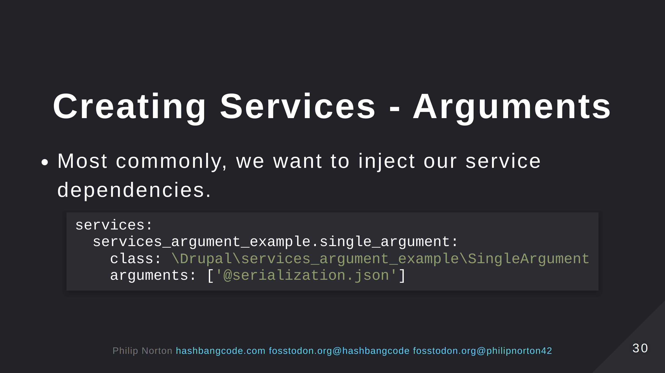

Slide 31
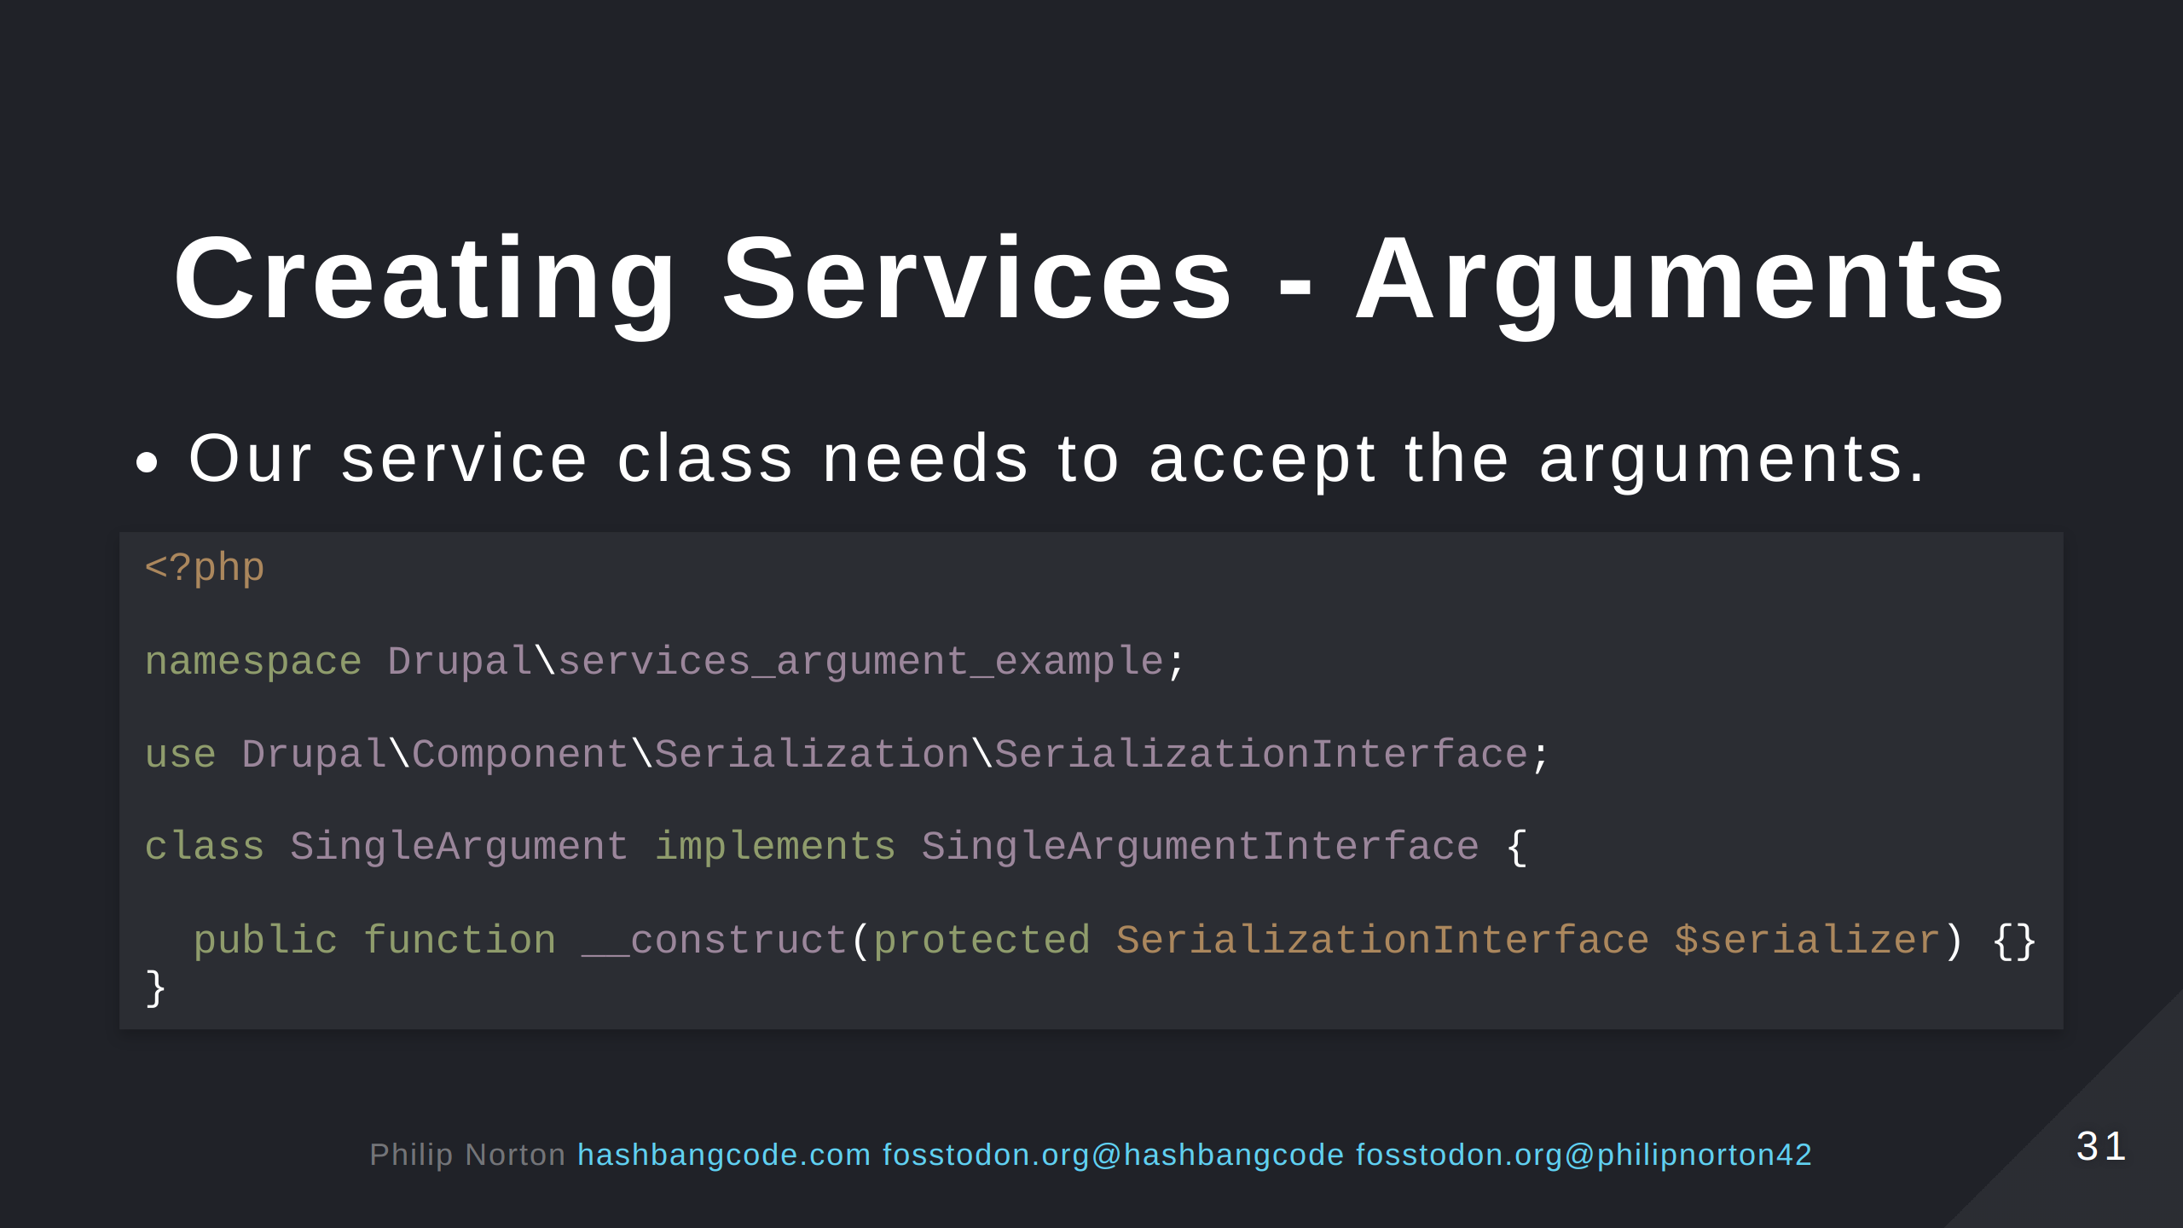
Notes:
This is call constructor property promotion. The $serialiser property is created in our class. This follows SOLID principles again, in this case the dependency inversion principle.

Slide 32
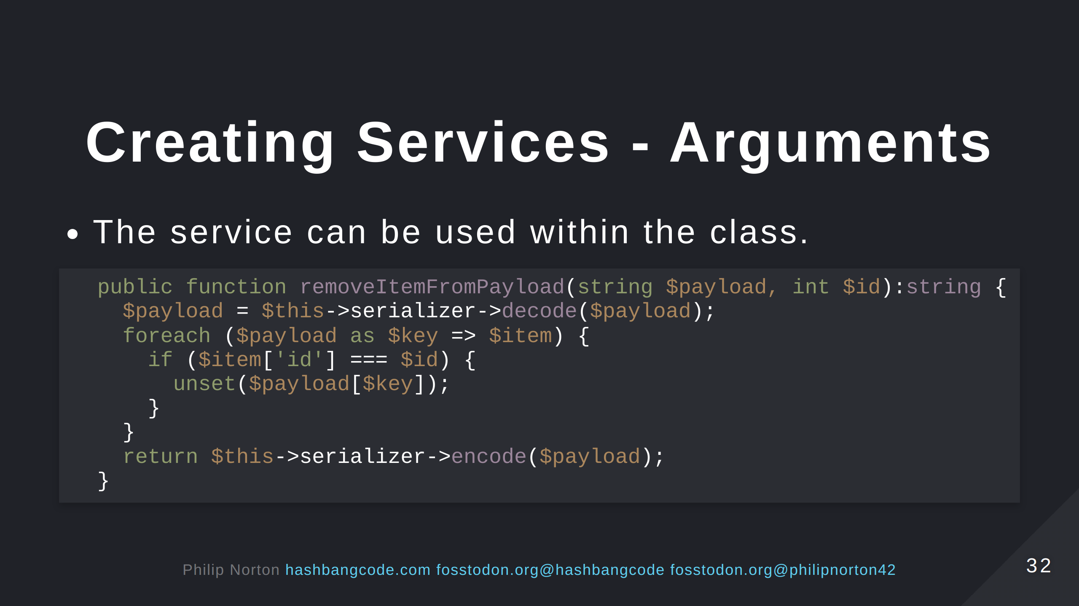

Slide 33
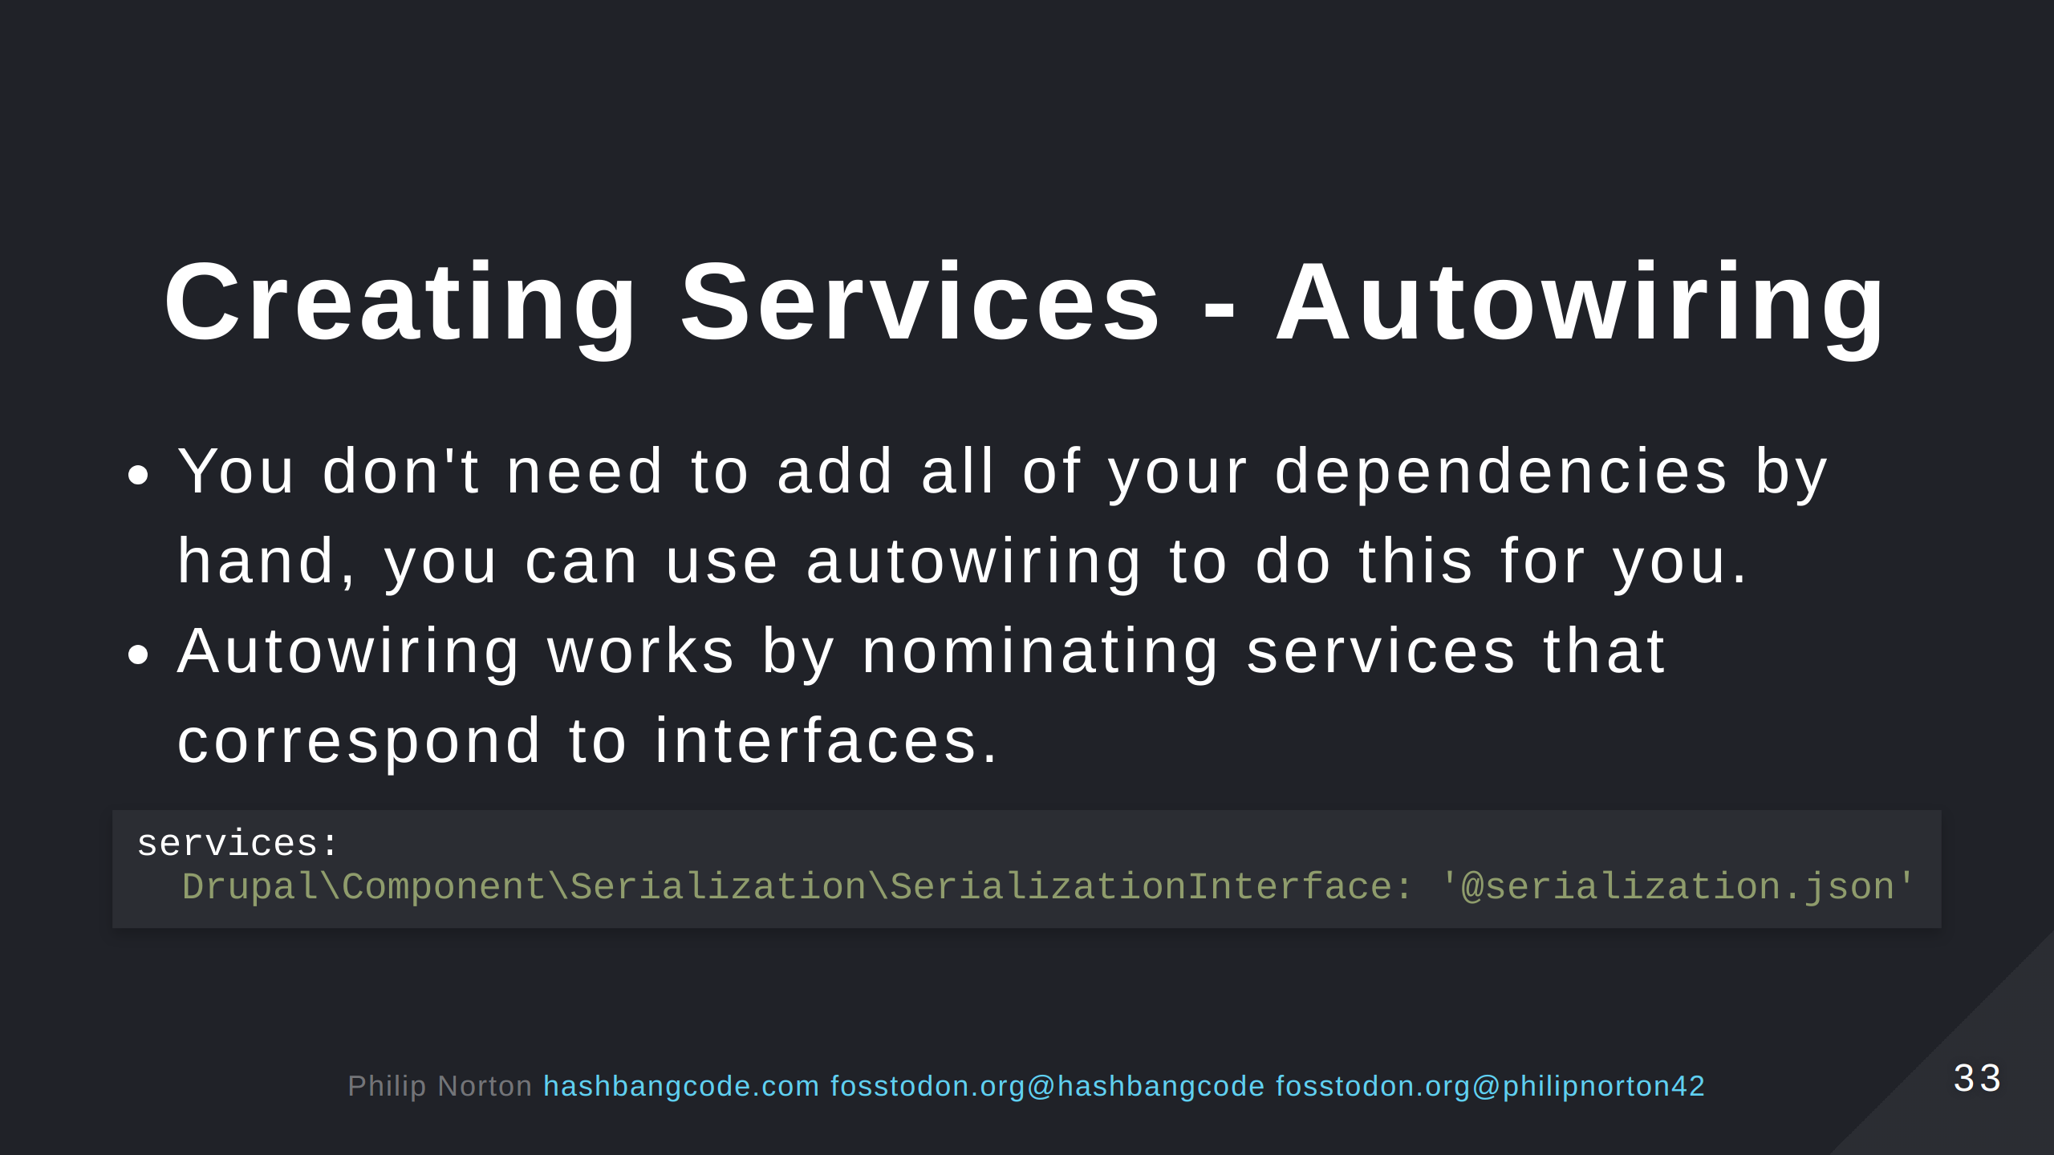
Notes:
Here,

Slide 34
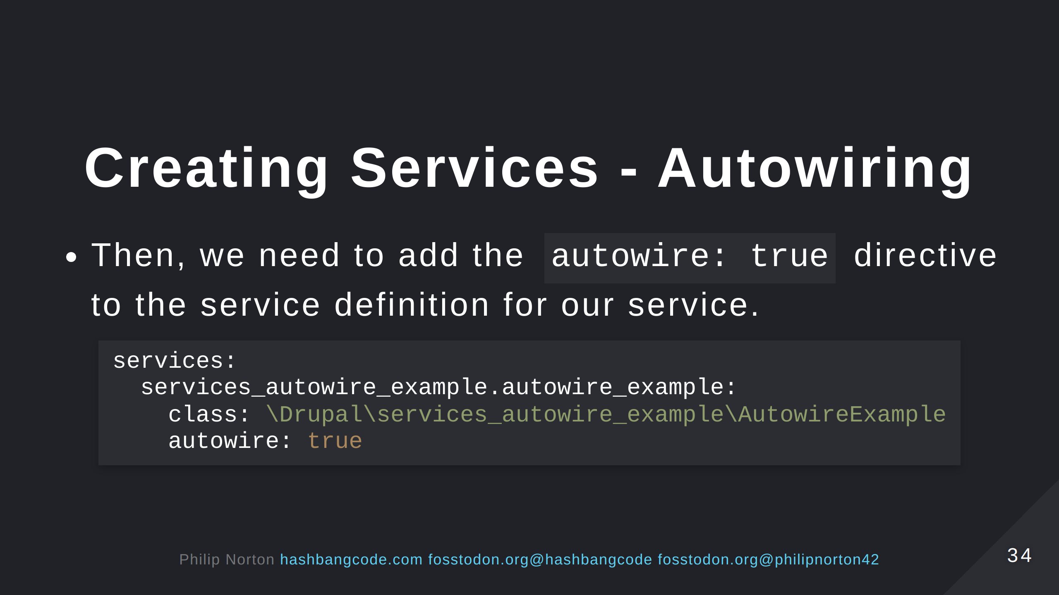

Slide 35
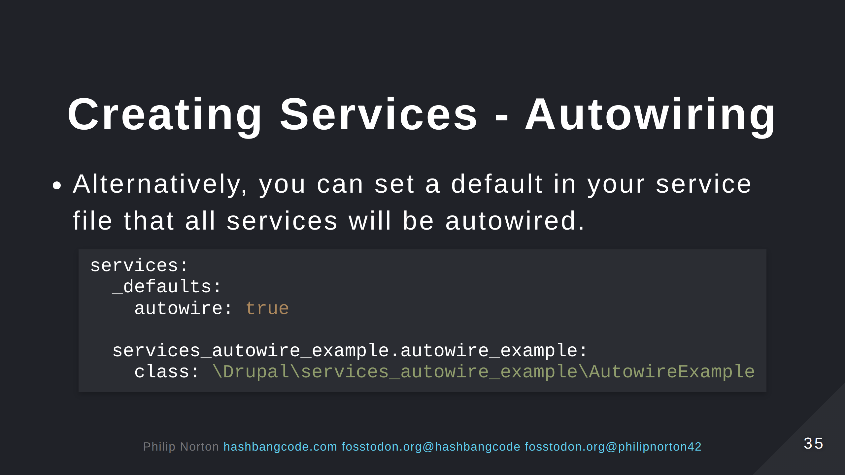

Slide 36
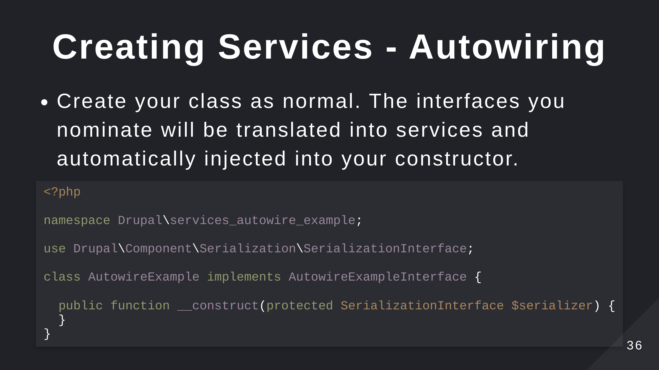

Slide 37


Slide 38
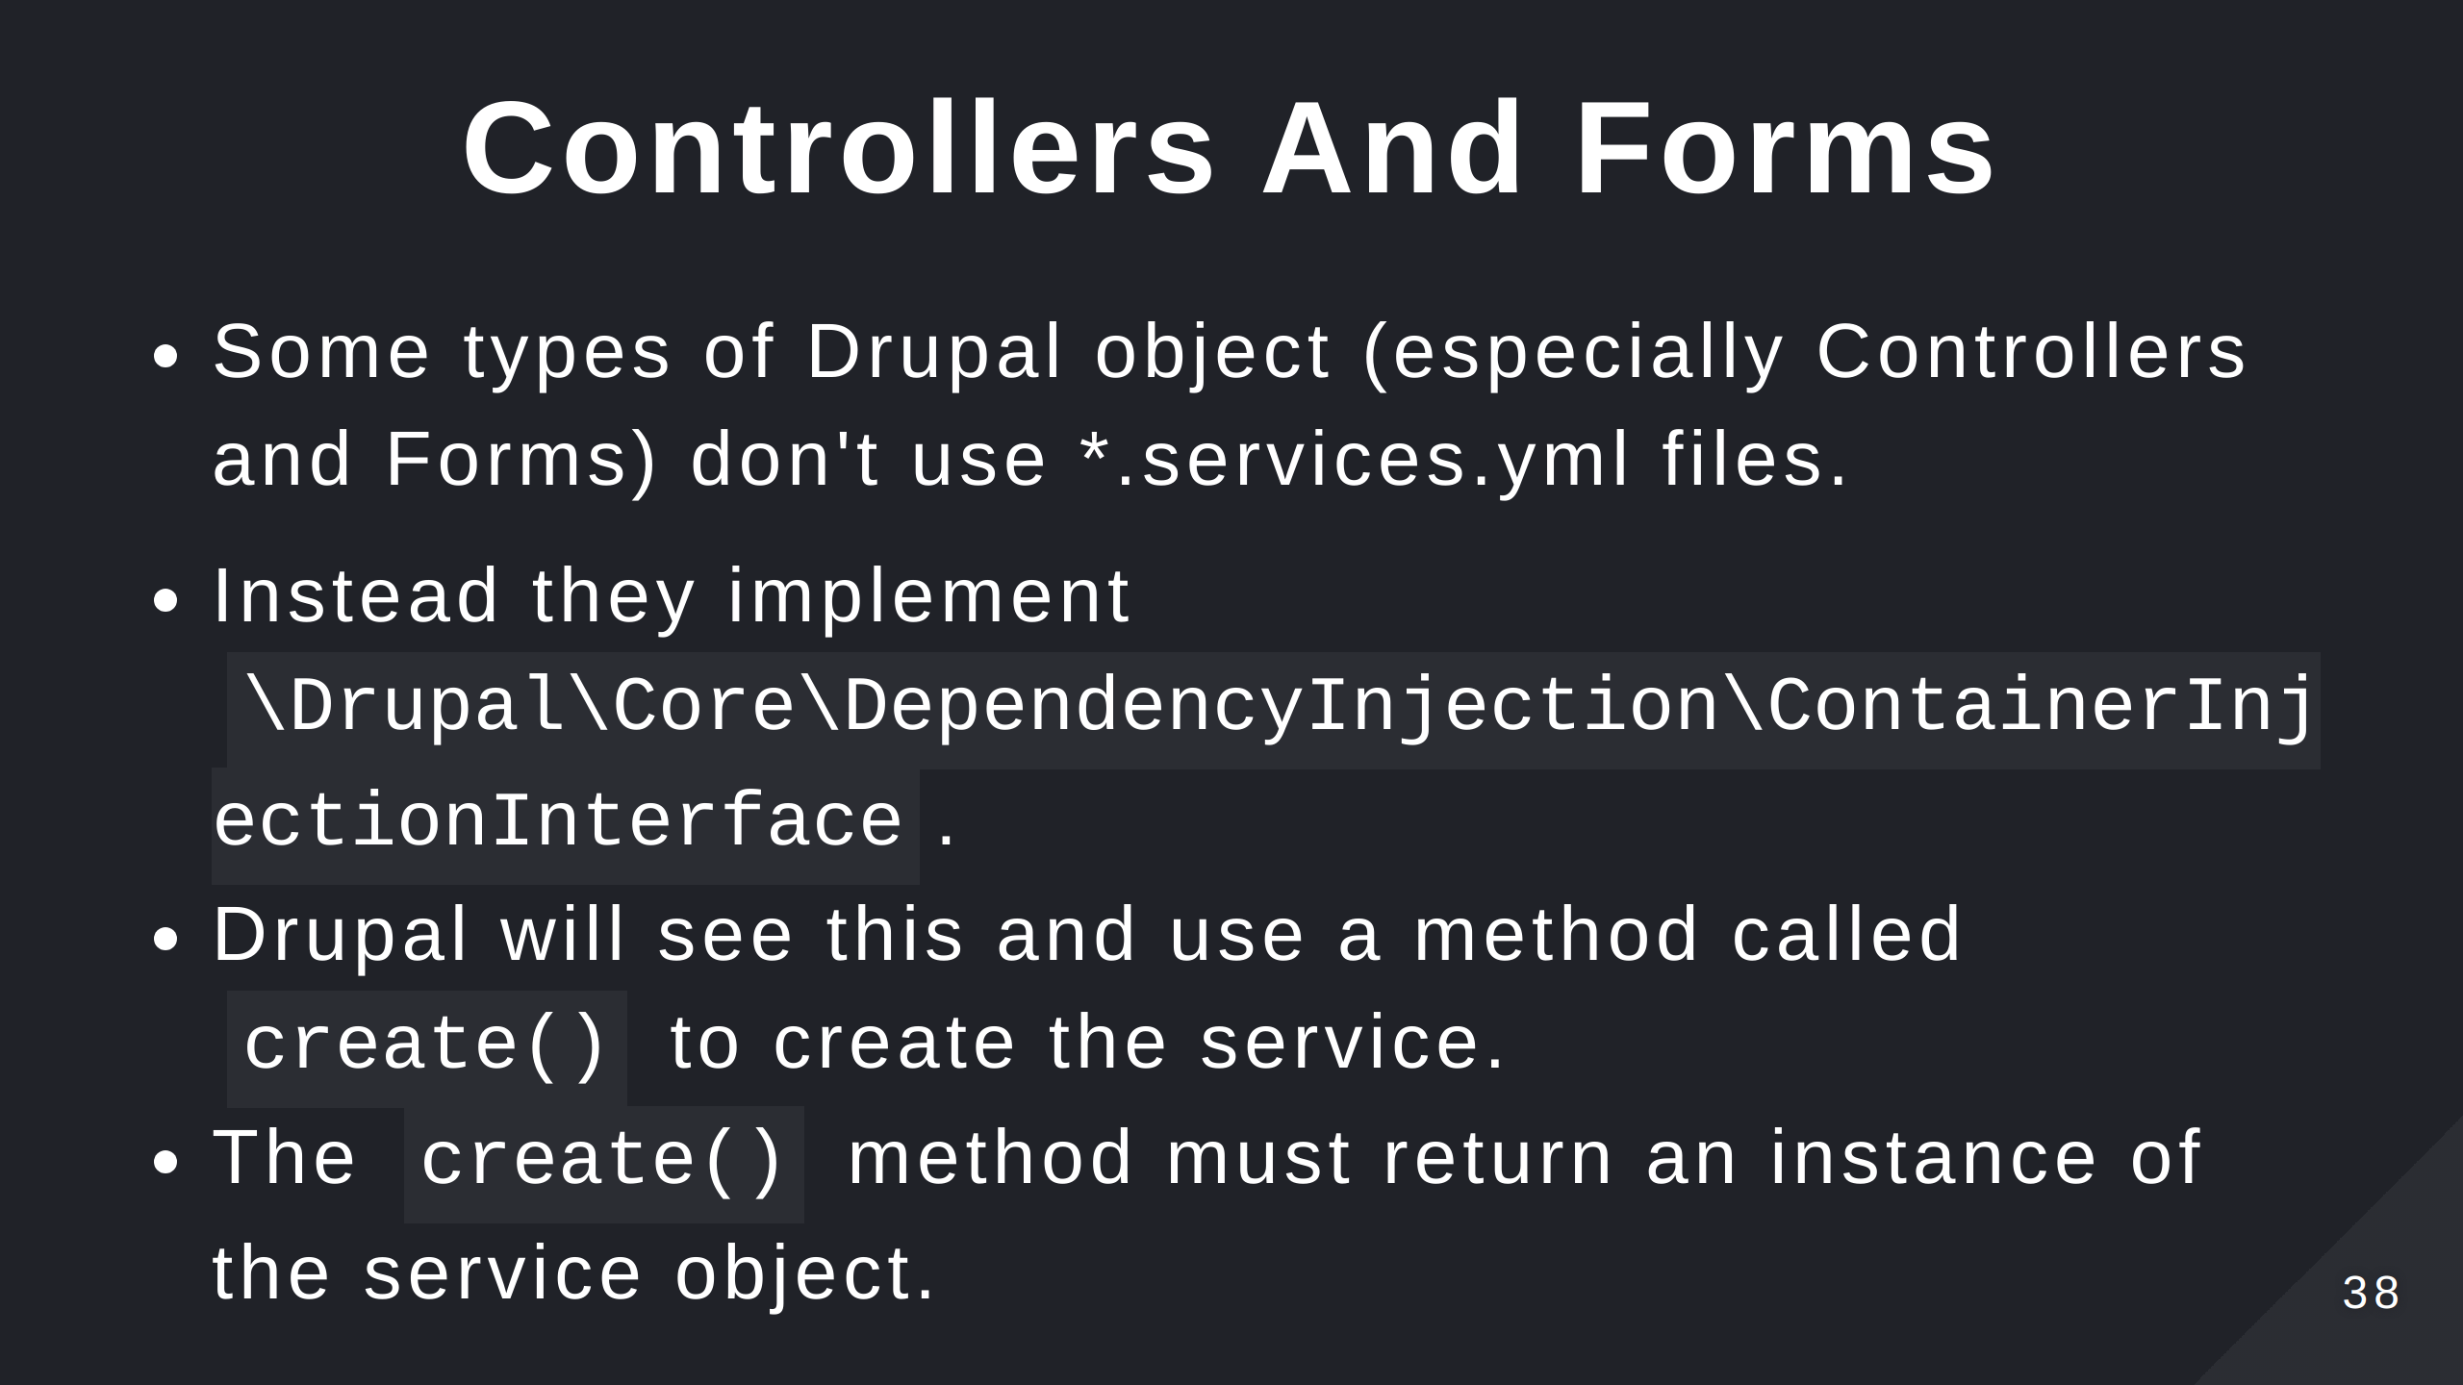

Slide 39
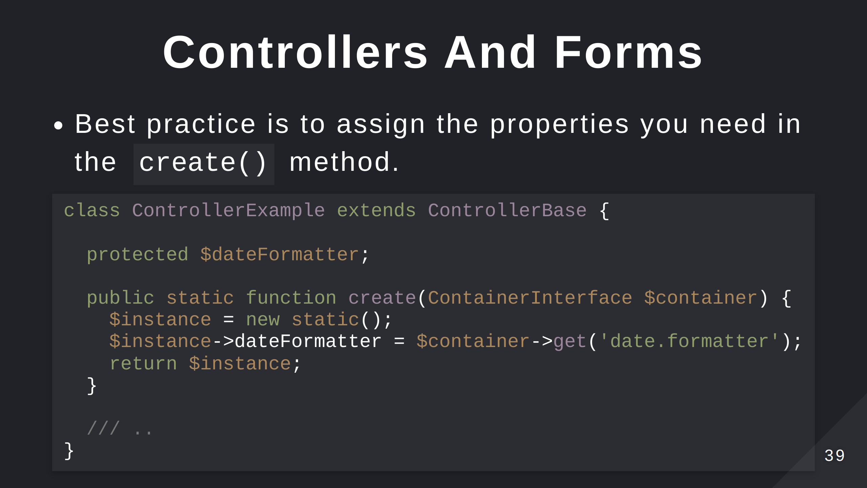

Slide 40
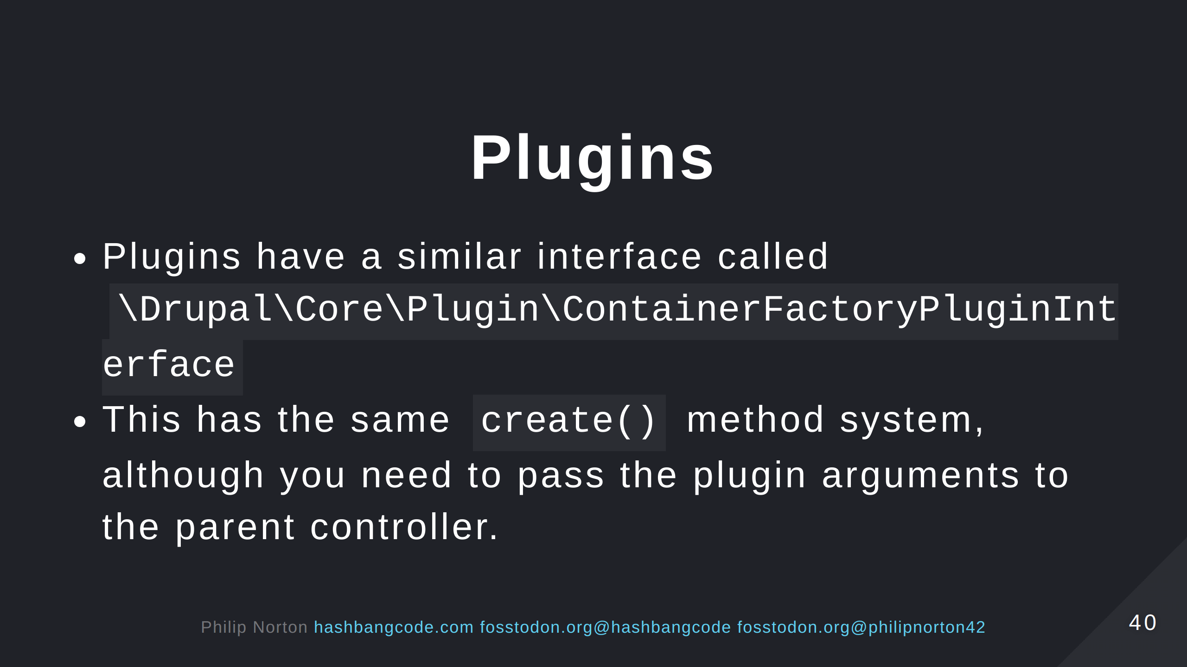
Notes:
Plugins work in the same way, but plugins will have additional arguments that need to be passed upstream.

Slide 41
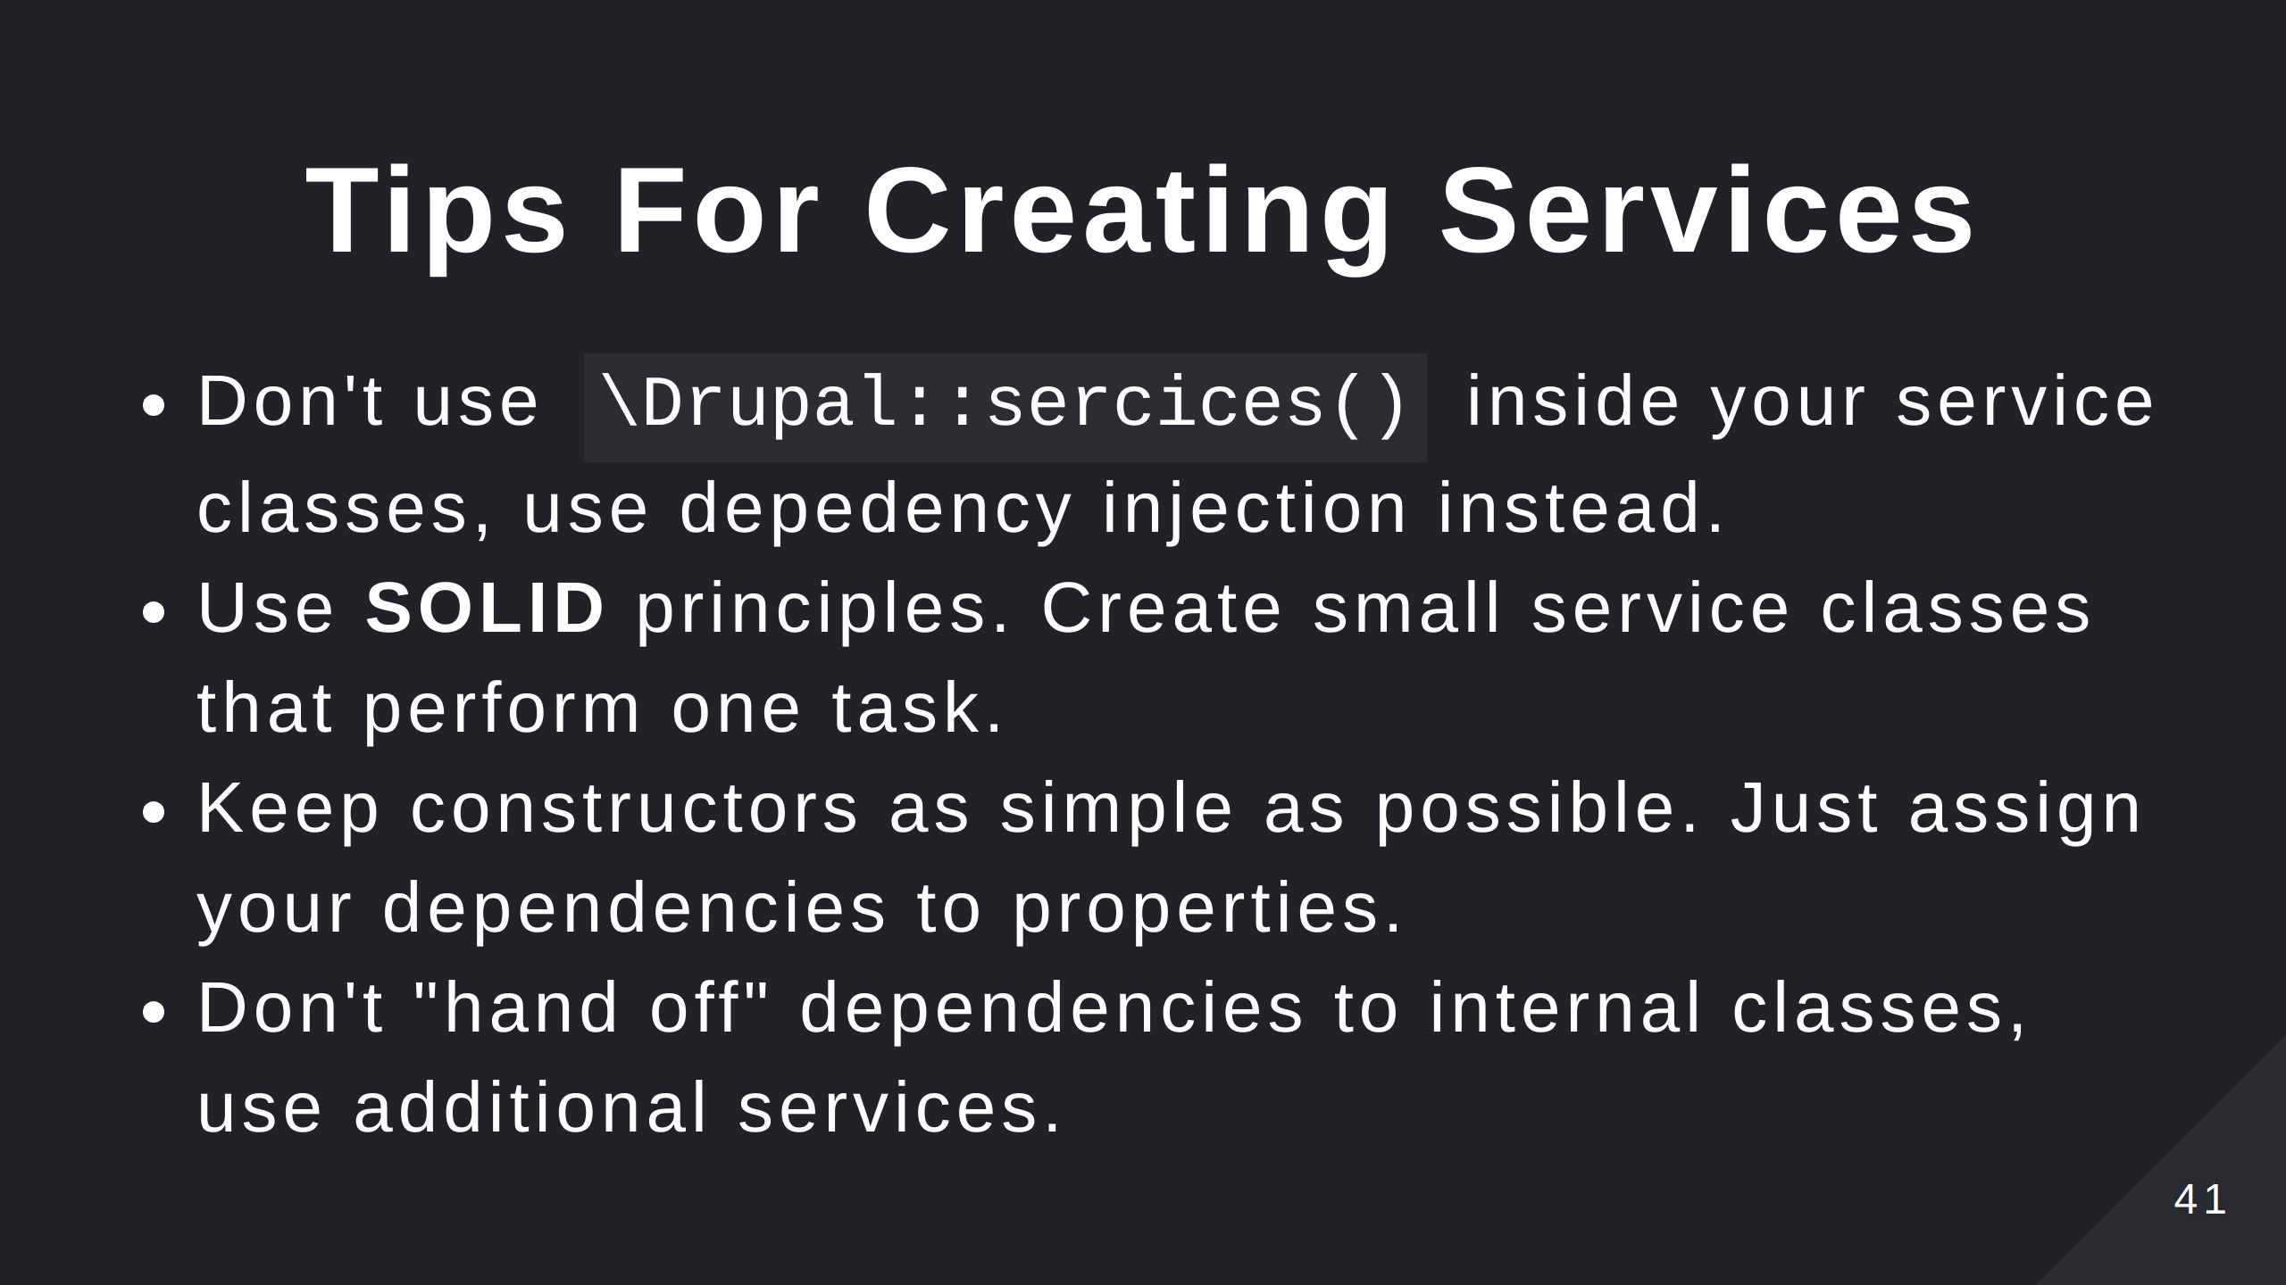

Slide 42
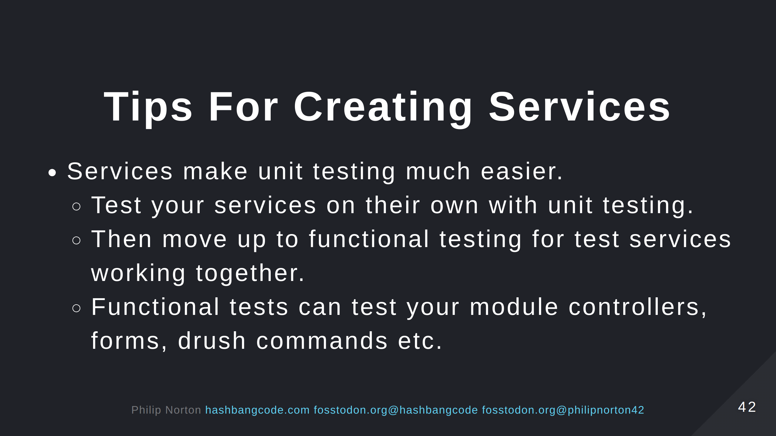

Slide 43
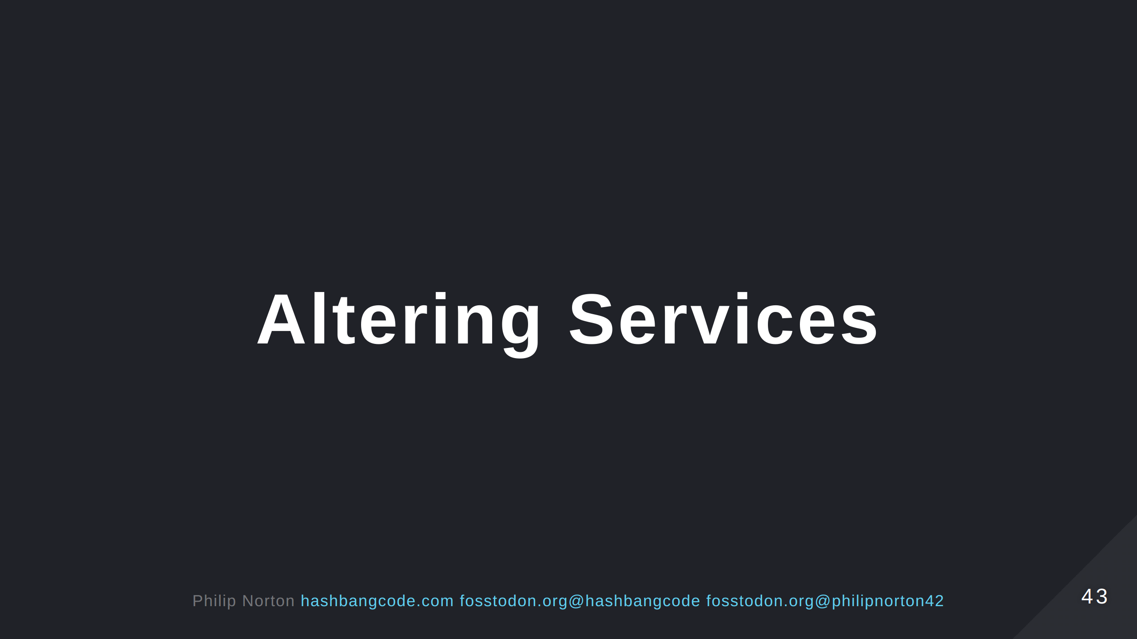

Slide 44
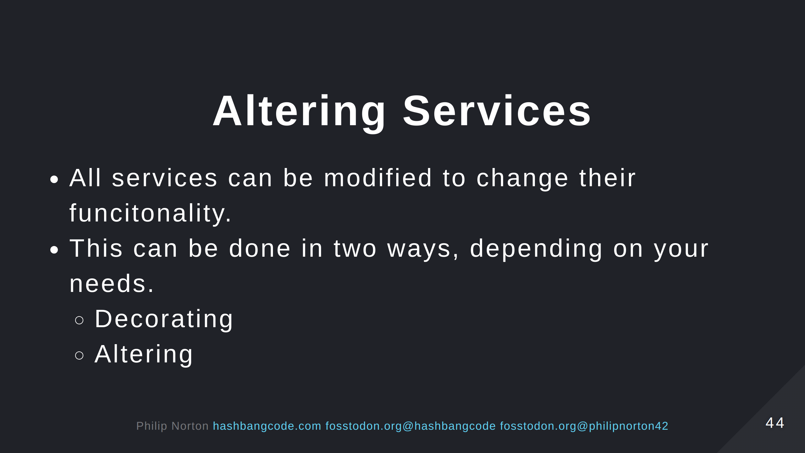

Slide 45
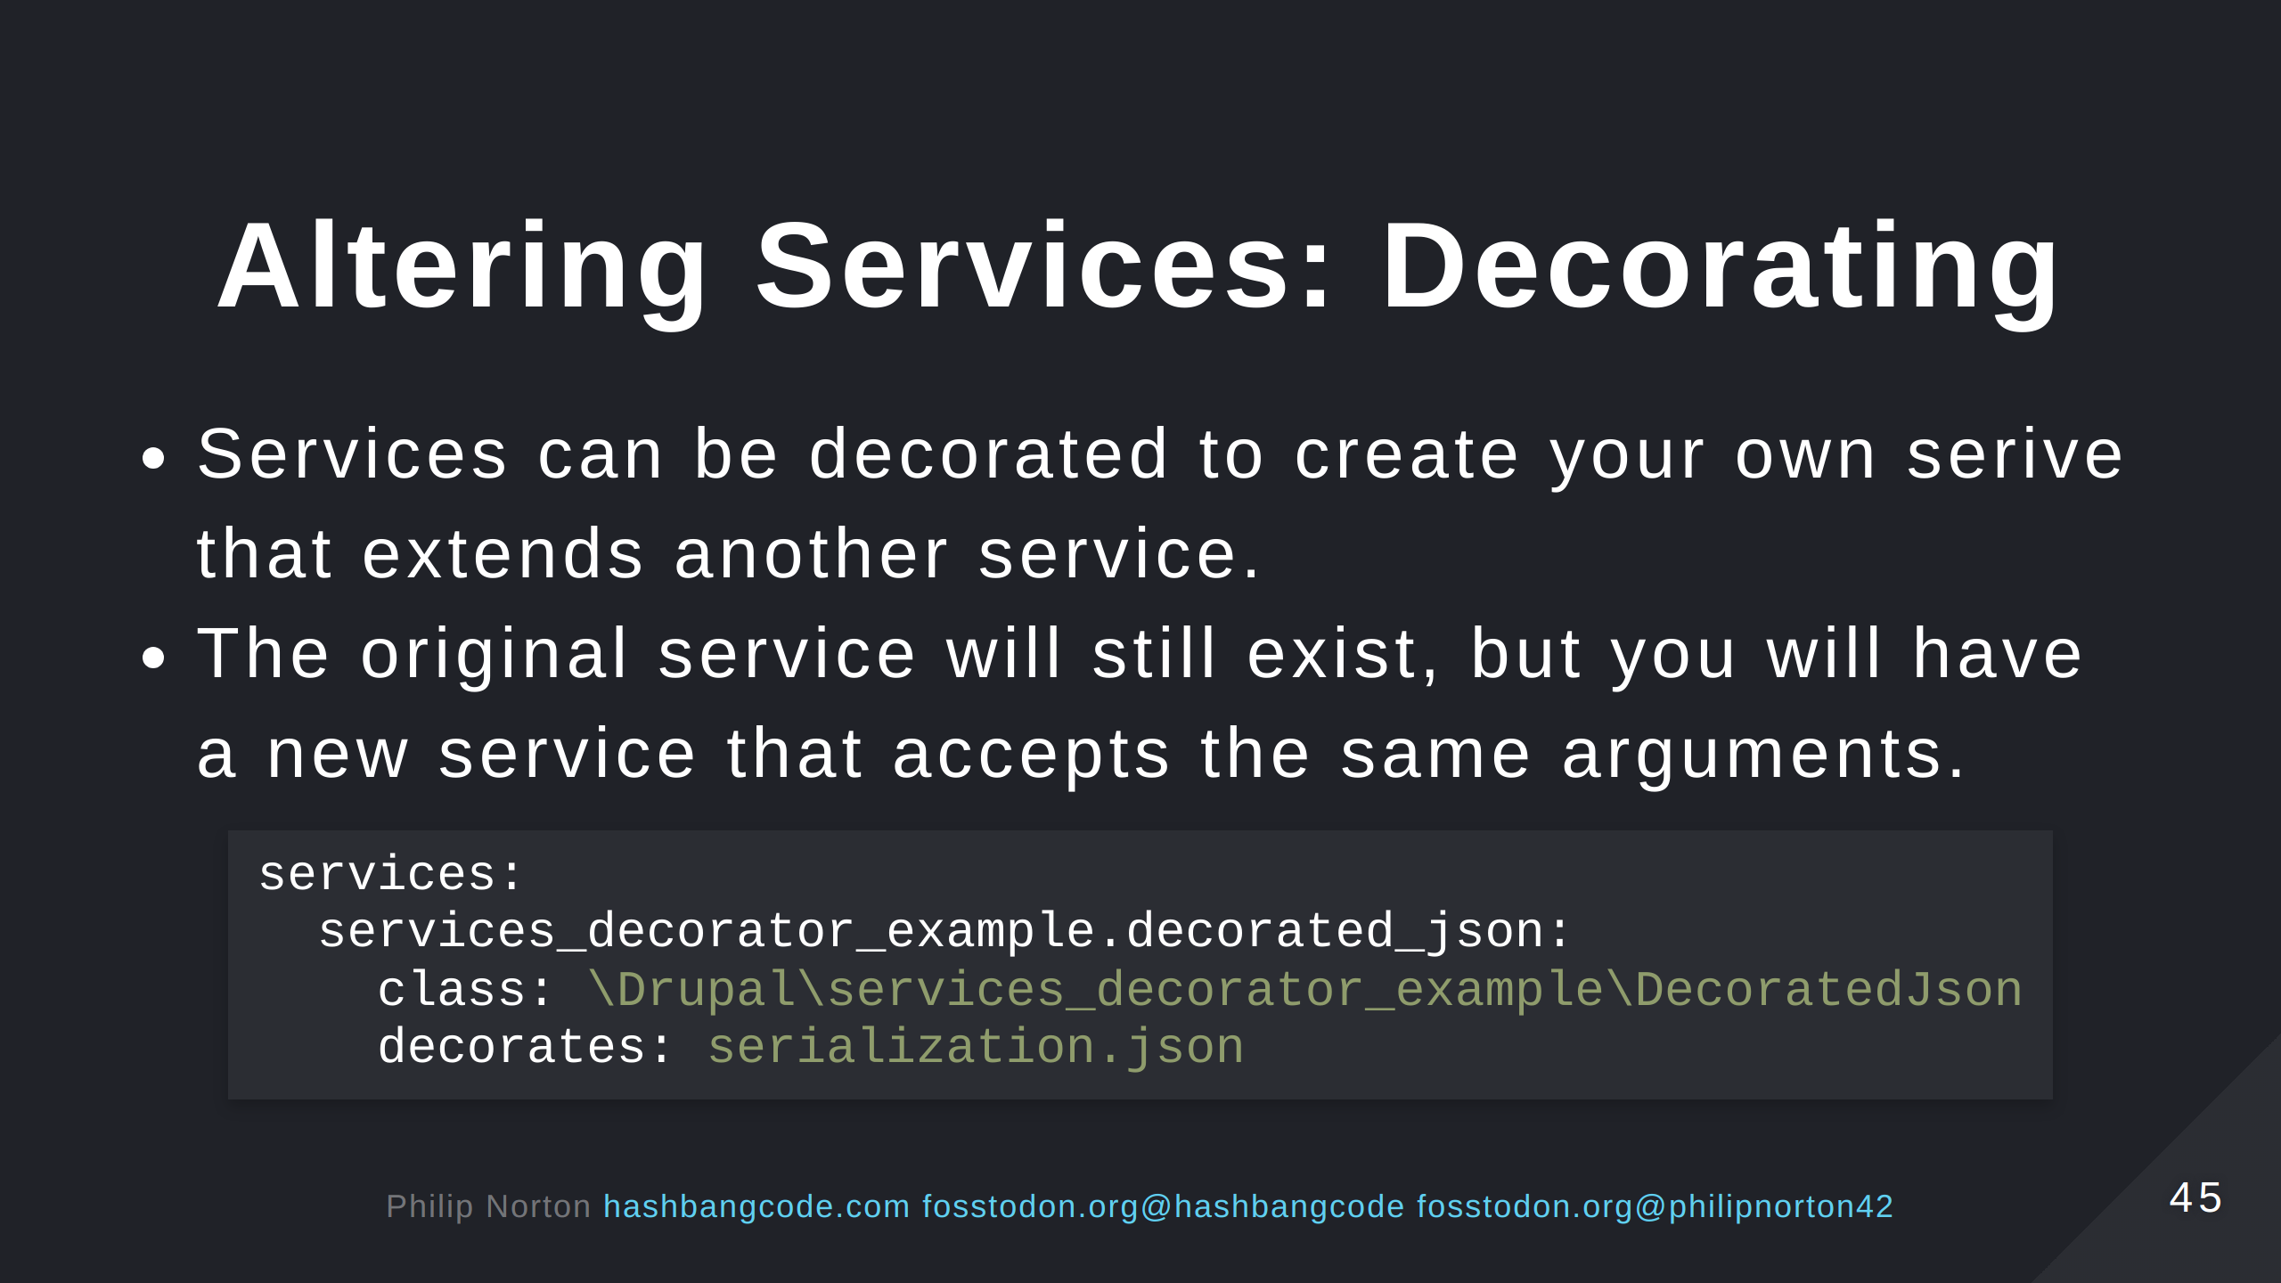
Notes:
Here, we are decorating the serialization.json and creating our own service called services_decorator_example.decorated_json. The critical thing is that the existing service class still exists. The new service just extends that.

Slide 46
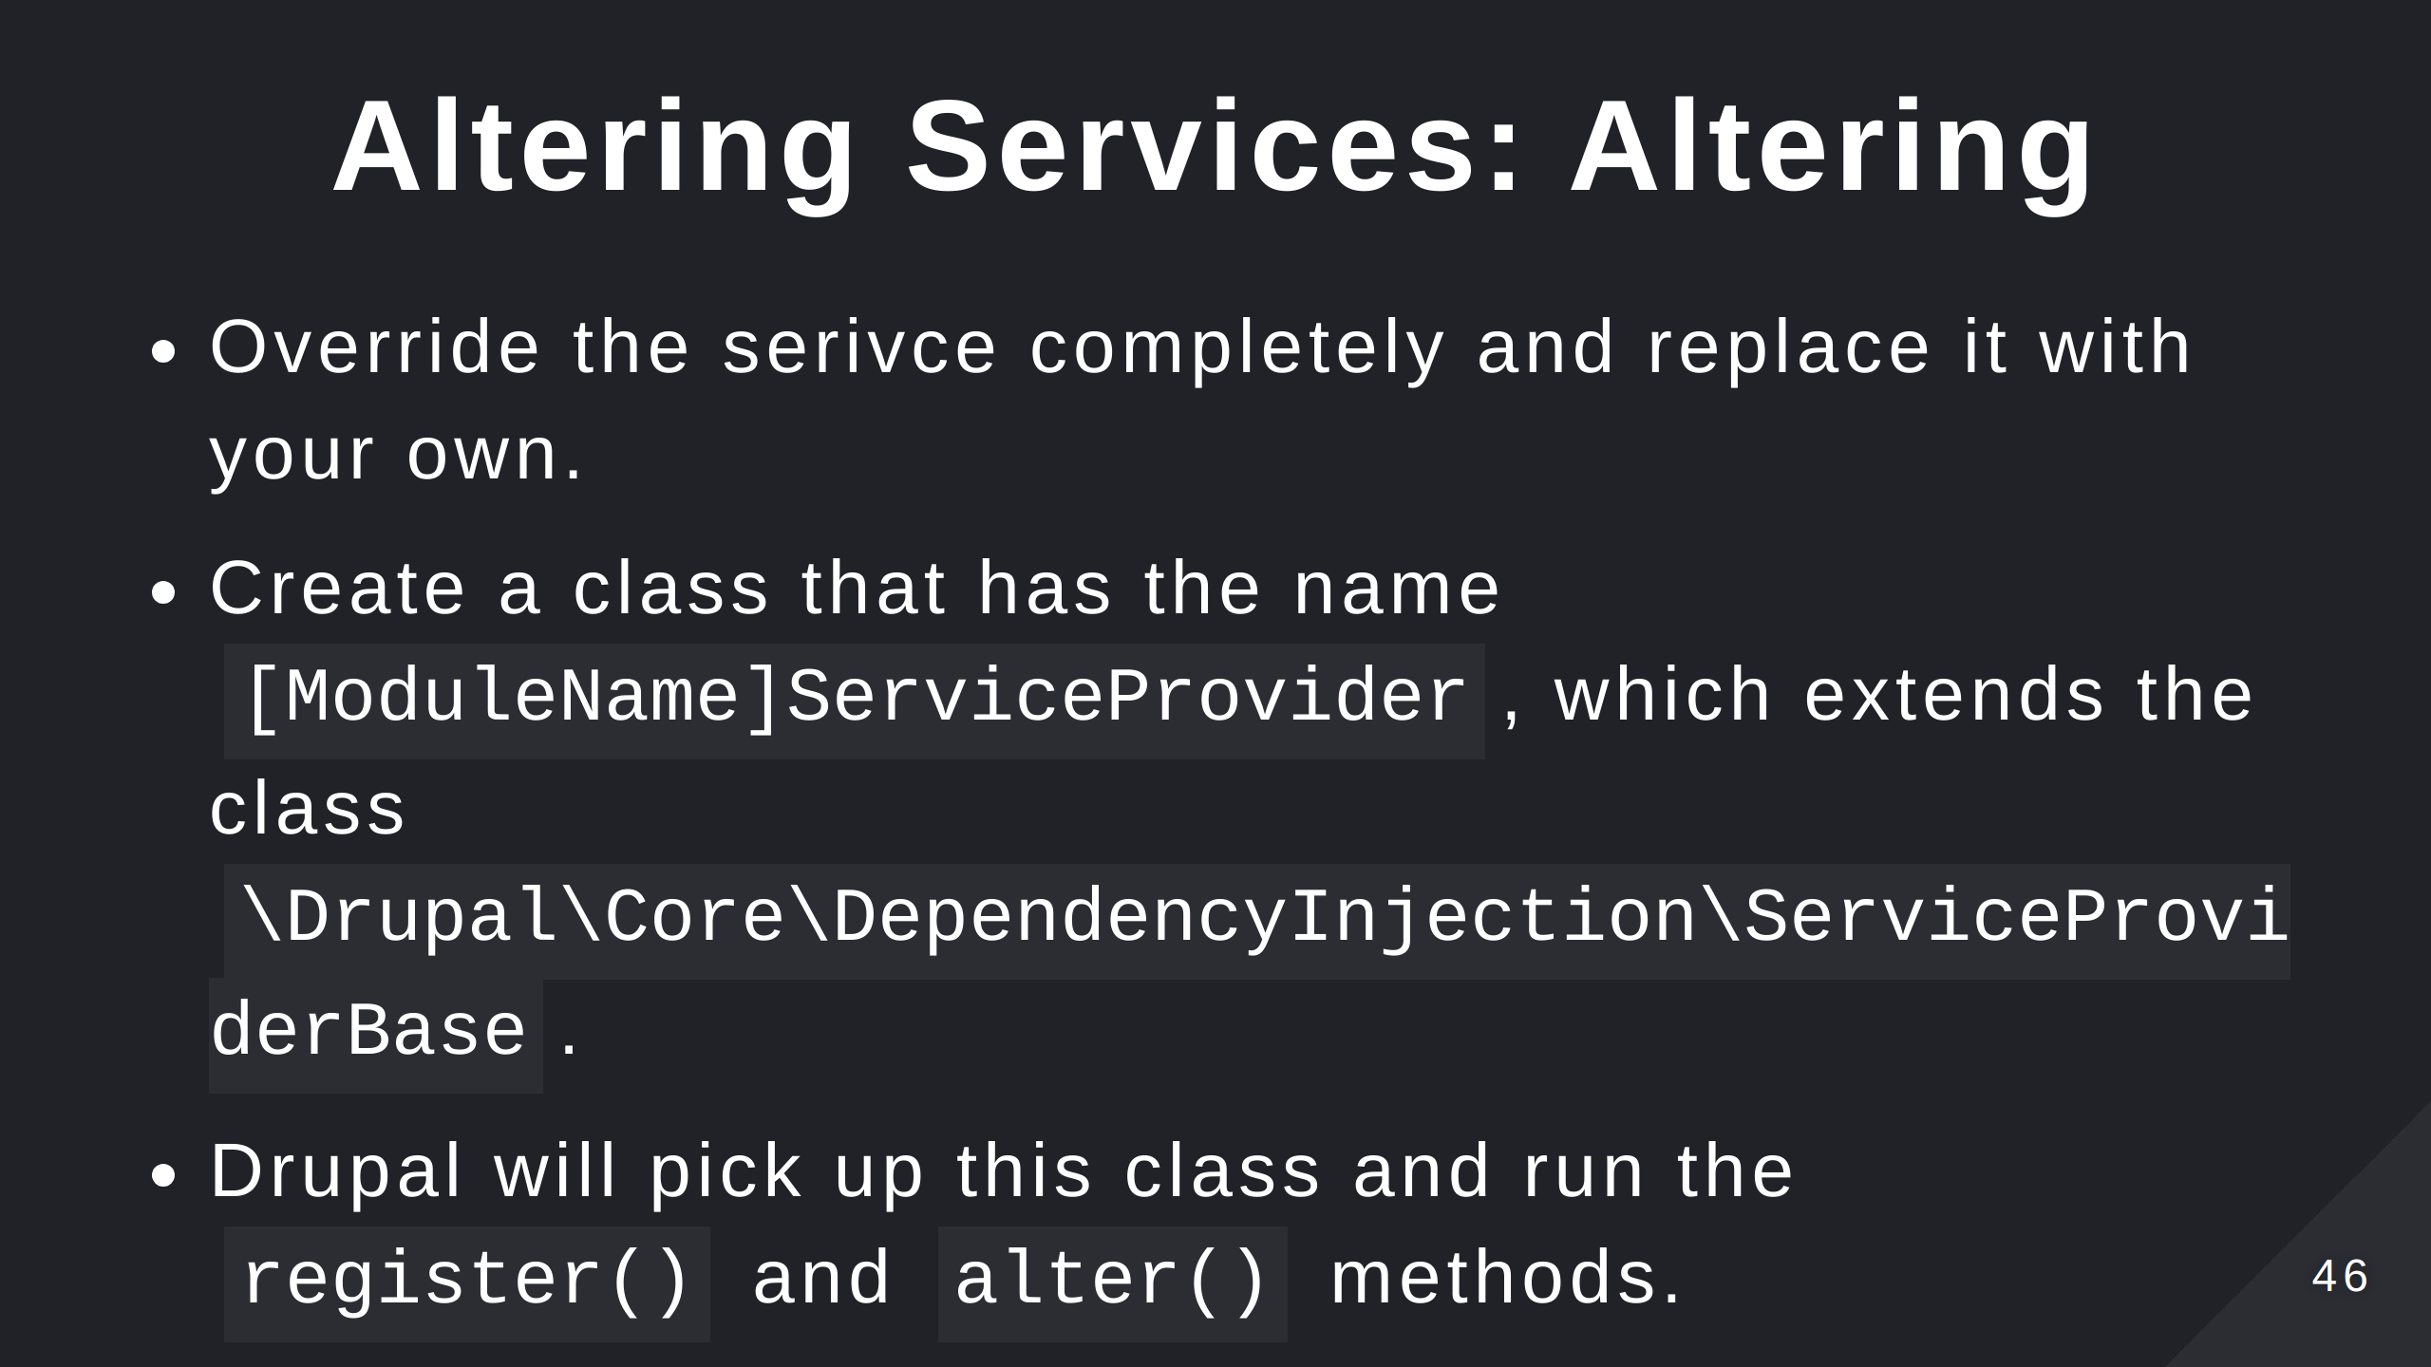
Notes:
Use register() to register a new service in Drupal. Useful for highly dynamic services where you want to automatically discover your services at run time. Use alter() to alter the service registry and change any registered service in the site.

Slide 47
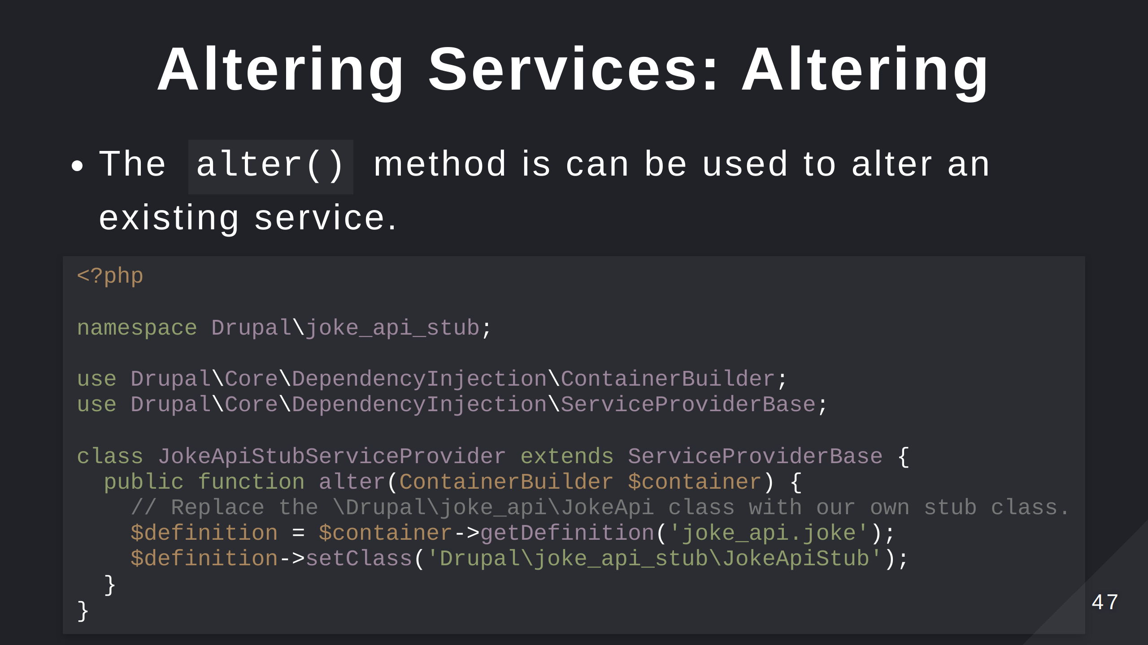
Notes:
Here, we are altering the joke_api.joke service to replace it with our a stub service that doesn't integrate with the Joke API.

Slide 48


Slide 49
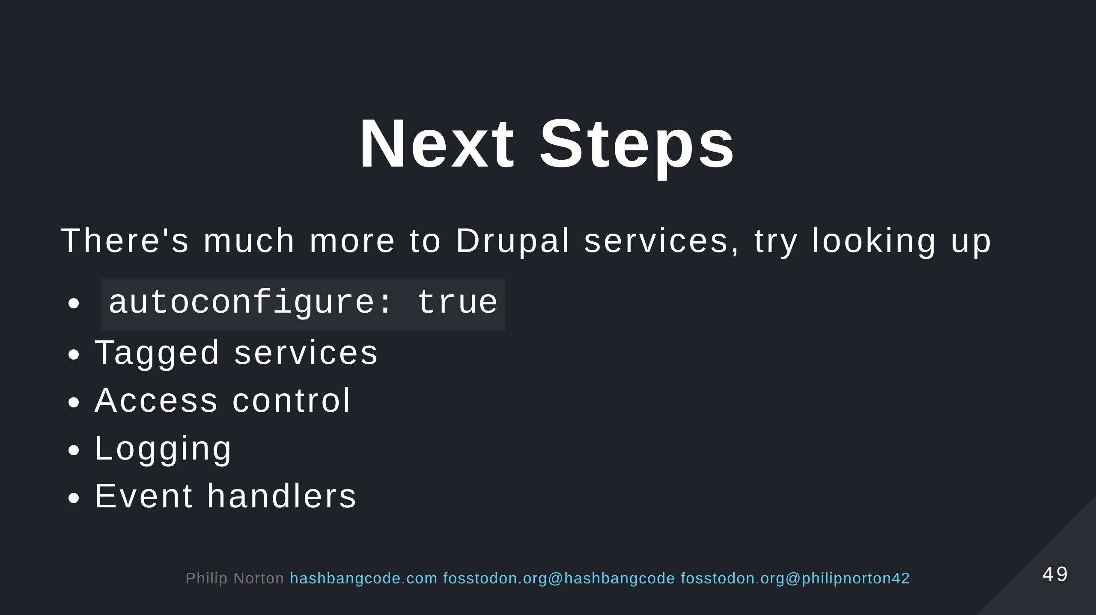

Slide 50
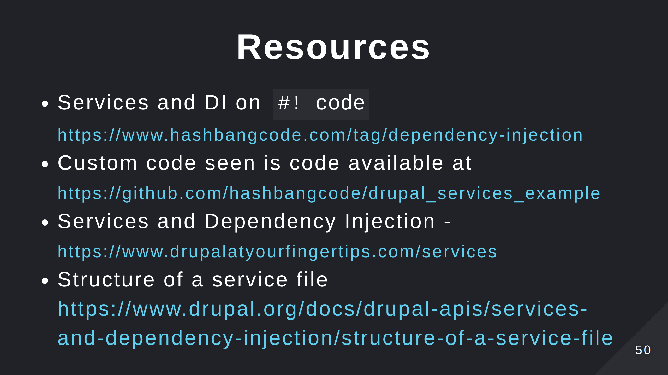
Notes:
- See the list at the repo page https://github.com/hashbangcode/drupal-services-talk.

Slide 51


Slide 52


